Slide 1


Panaverse DAO
Web 3.0 User Manual
Join the Future Now
Zia Khan
MA, MBA, MAC, MSE, CPA, and CMA
https://www.linkedin.com/in/ziaukhan/
www.panaverse.co
Notes:
https://pixlr.com/x/#editor

Slide 2
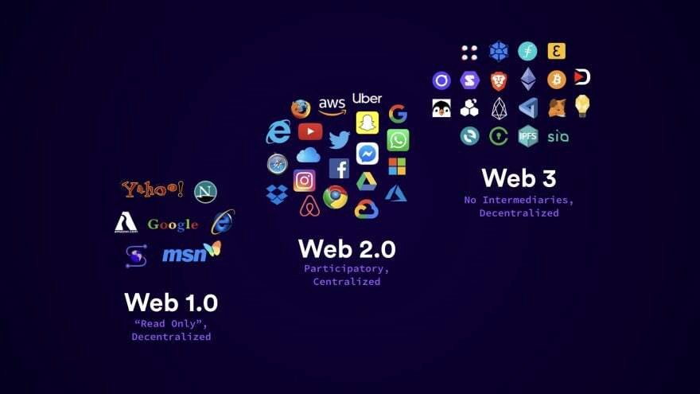

Slide 3
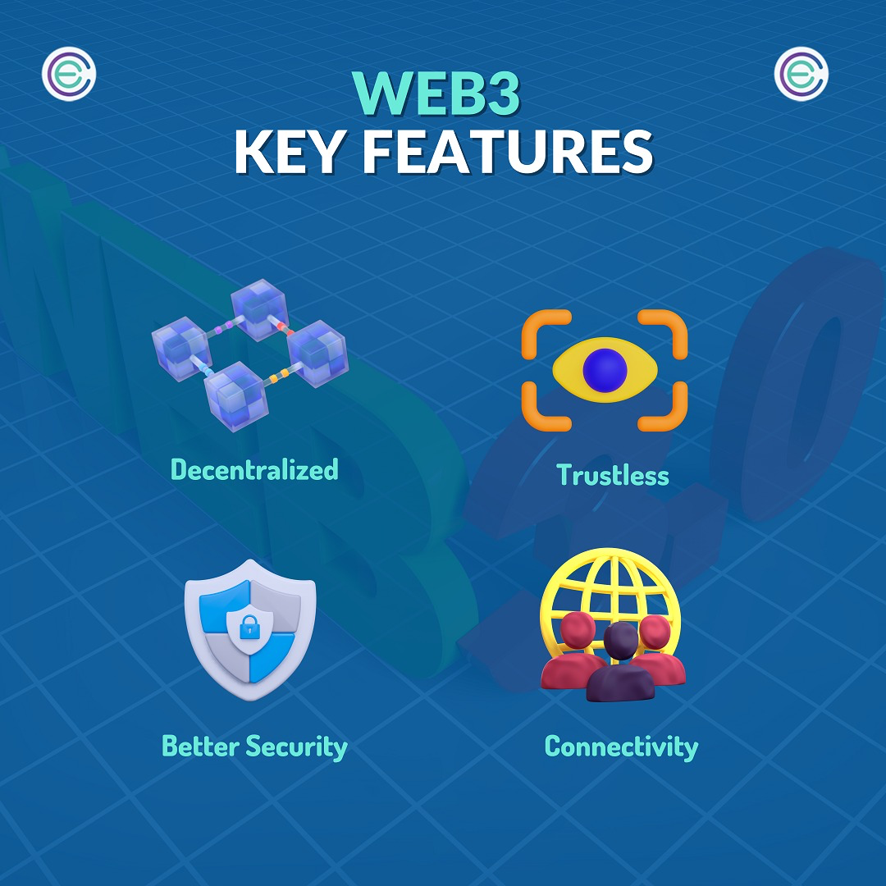

Slide 4
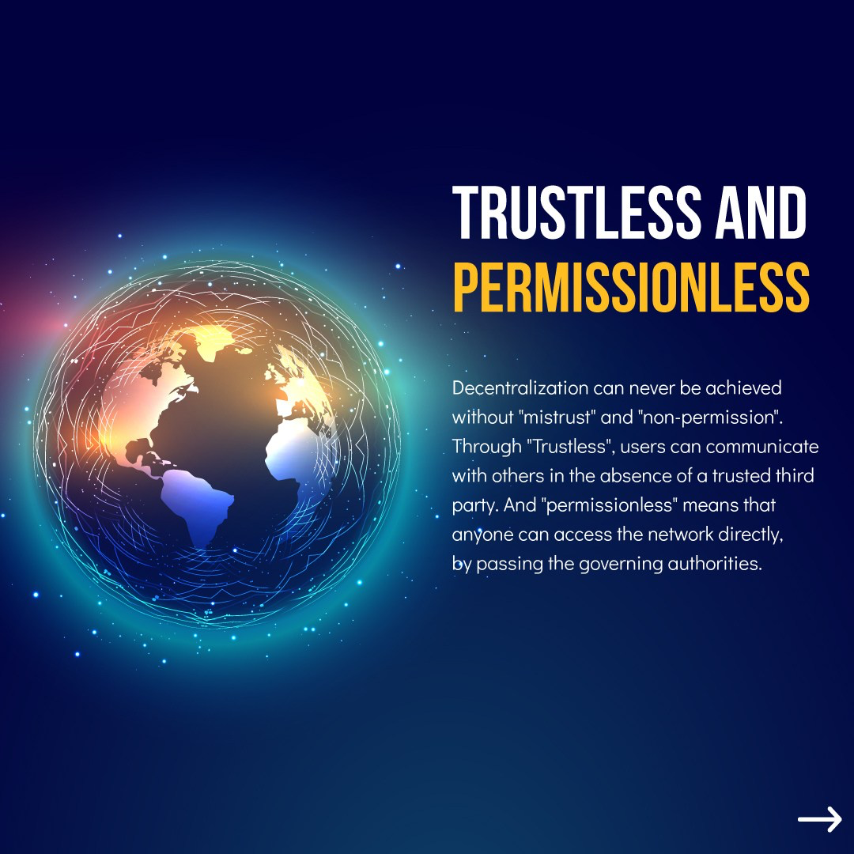

Slide 5
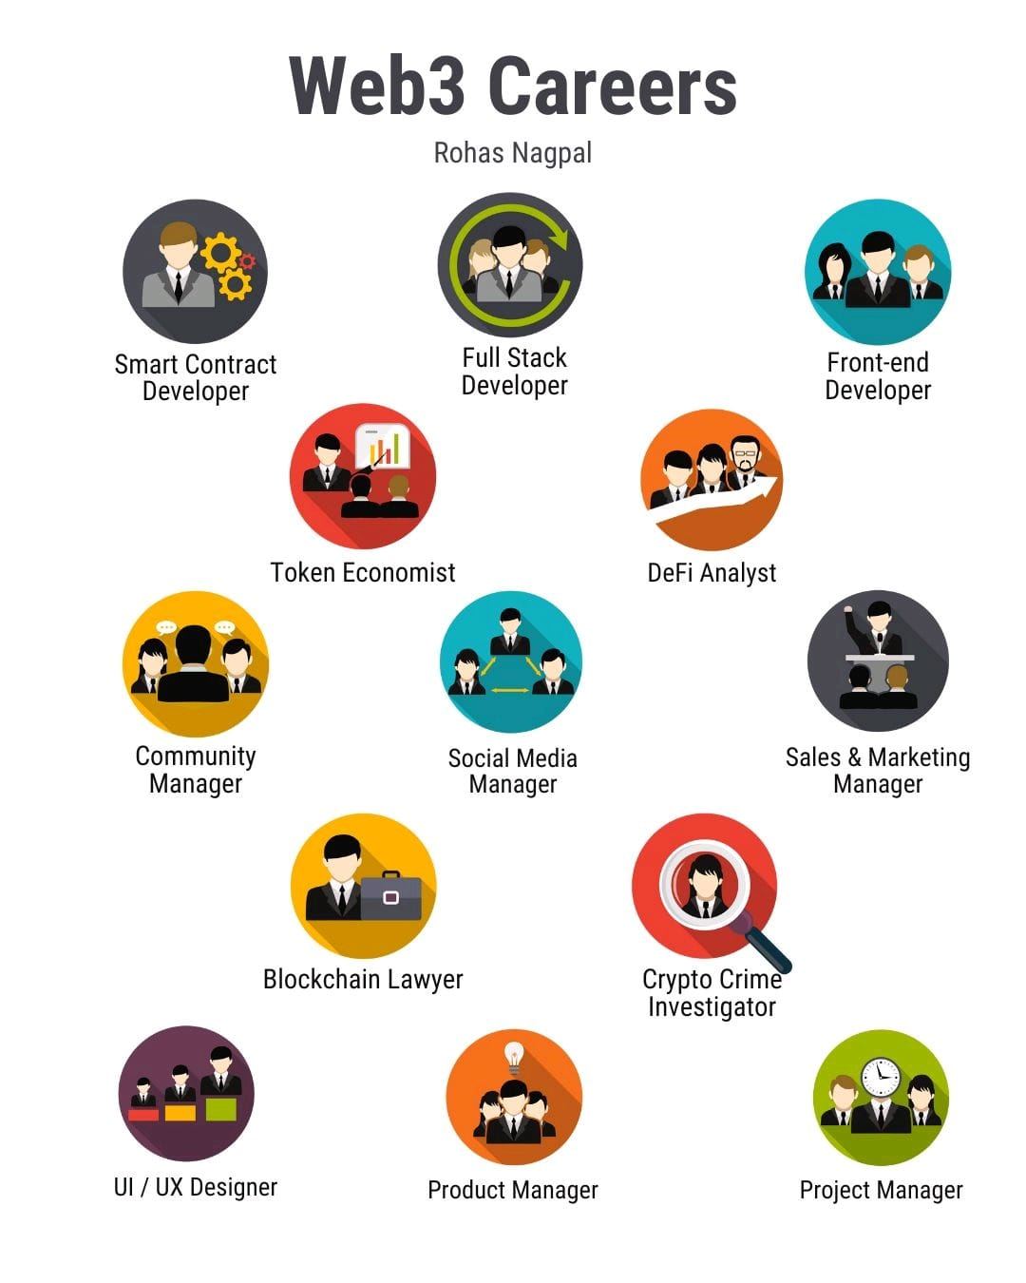

Slide 6
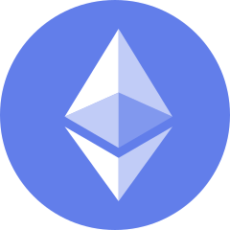
What is Ethereum?
Ethereum was launched back in 2015 and is famous for being a decentralized and open-source proof-of-stake blockchain with smart contracts functionality.
One of Ethereum’s biggest strengths is its variety of use cases, and the list keeps on growing every year.
As with Bitcoin, it is a large database of all the transactions conducted on the Ethereum Network.
A database usually structures its data into tables, whereas a blockchain, as its name implies, structures its data into chunks (blocks) that are strung together.
Notes:
This text is initially created by the Changelly team. Read more at https://changelly.com/blog/ethereum-eth-price-predicti

Slide 7
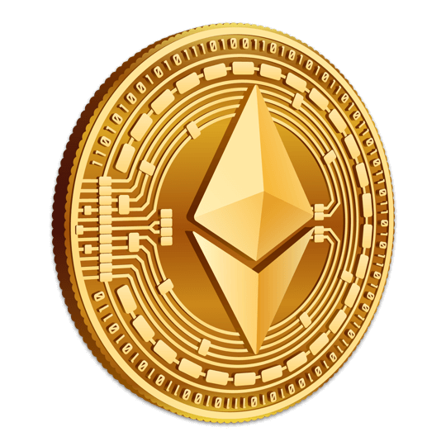
What is Ether (ETH)?
Ether is the transactional token that facilitates operations on the Ethereum Blockchain network.
While ether is the cryptocurrency of the Ethereum network, metaphorically speaking, it is more accurate to refer to it as the "fuel" of the network.
Ether is the world’s second-largest virtual currency by market capitalization; it is second only to Bitcoin (BTC) according to market value.
ETH isn’t just a speculative asset; it has actual value.

Slide 8
Ethereum Base Units
Think of the smallest unit of ether – wei – as a penny. It takes a whole bunch of wei to make an ether. 10^18 wei, to be exact.
10^9 wei is a gwei. Gwei is most commonly used when talking about gas (network transaction fees). Rather than saying your gas cost is 0.000000001 ether you can say 1 gwei.

Slide 9
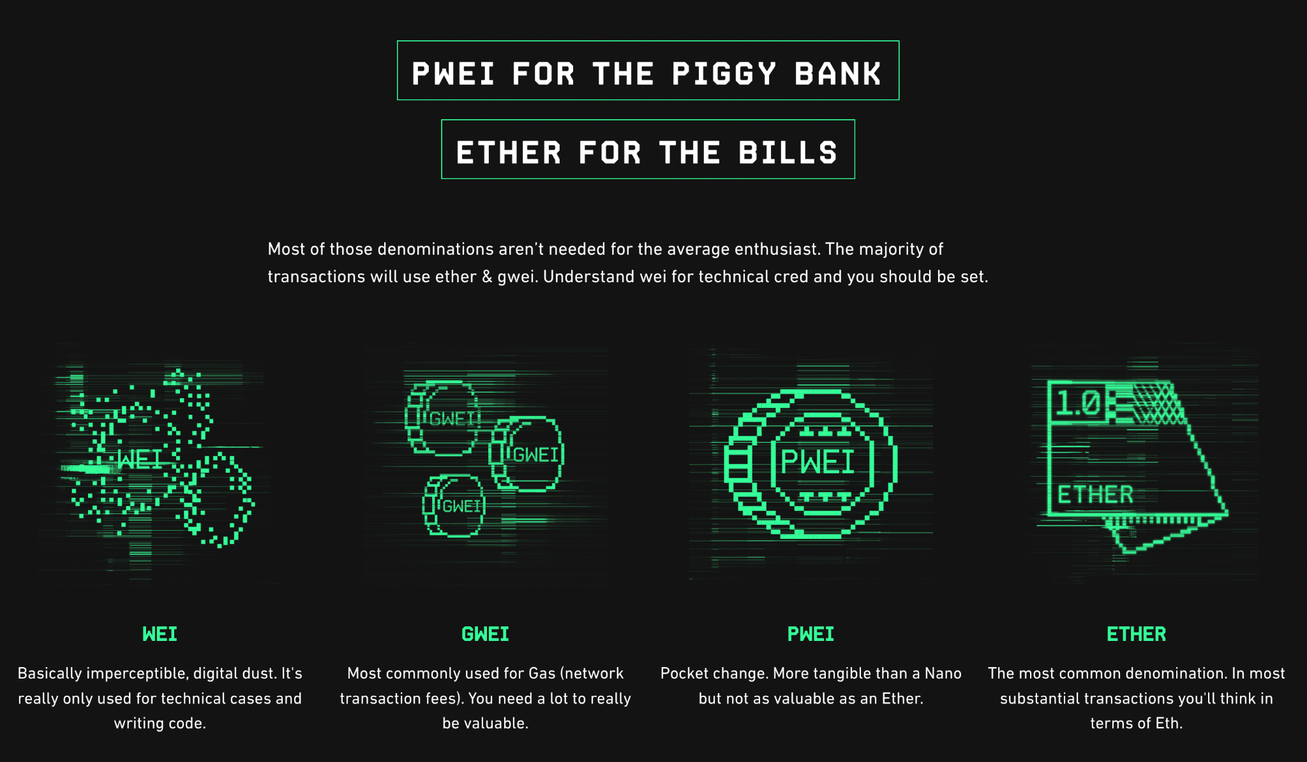
Notes:
https://gwei.io/

Slide 10
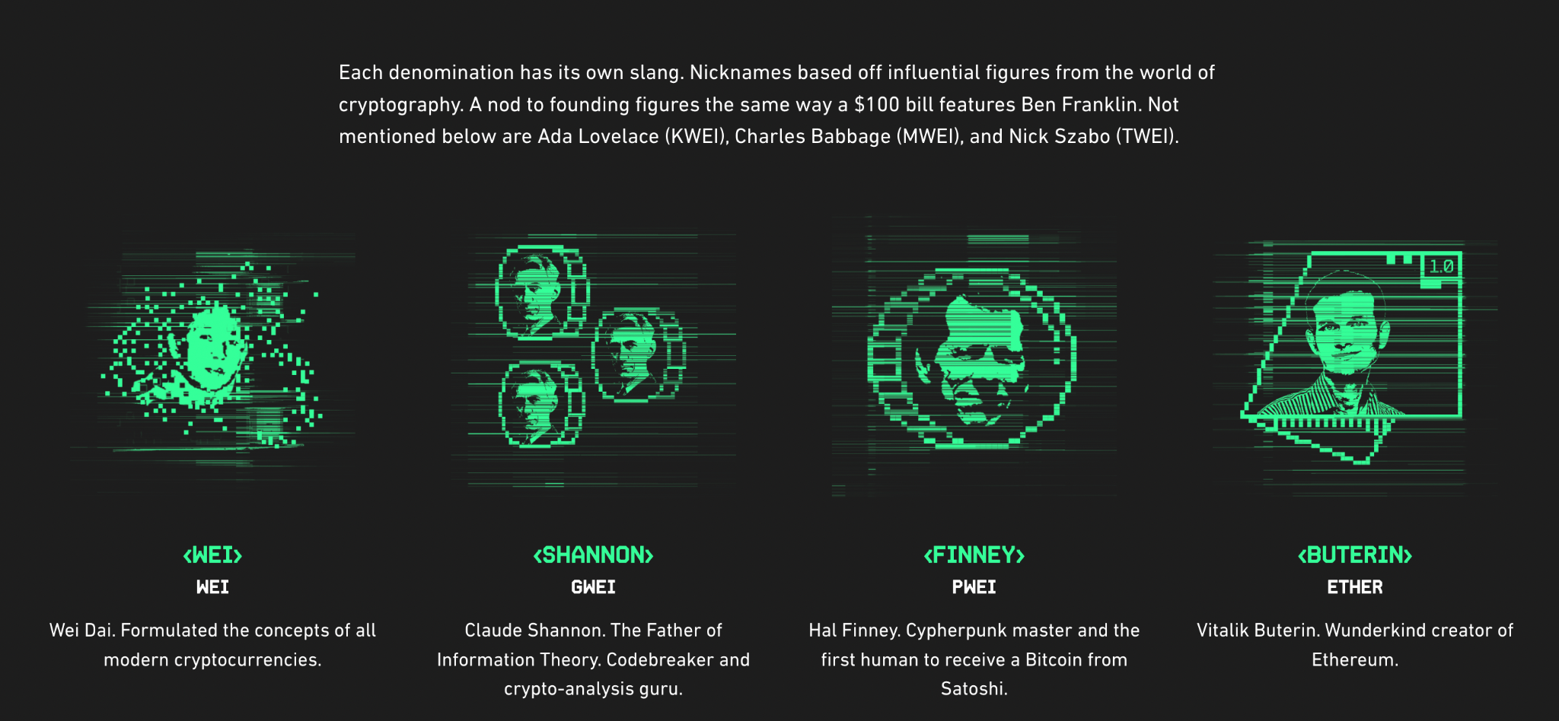
Notes:
https://gwei.io/

Slide 11
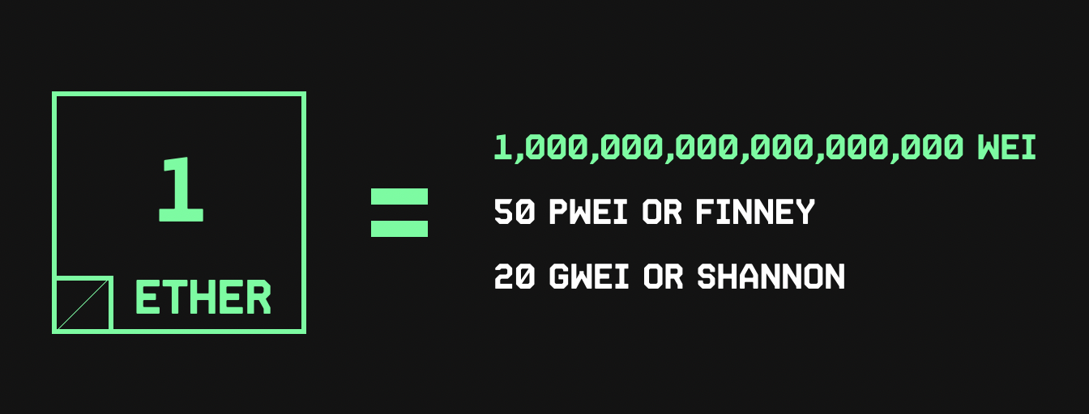

Slide 12
Ethereum Gas Fee
Gas is essential to the Ethereum network. It is the fuel that allows it to operate, in the same way that a car needs gasoline to run.
Gas refers to the unit that measures the amount of computational effort required to execute specific operations on the Ethereum network.
Since each Ethereum transaction requires computational resources to execute, each transaction requires a fee. Gas refers to the fee required to conduct a transaction on Ethereum successfully.
Gas fees are paid in Ethereum's native currency, ether (ETH). Gas prices are denoted in gwei, which itself is a denomination of ETH - each gwei is equal to 0.000000001 ETH (10-9 ETH).

Slide 13
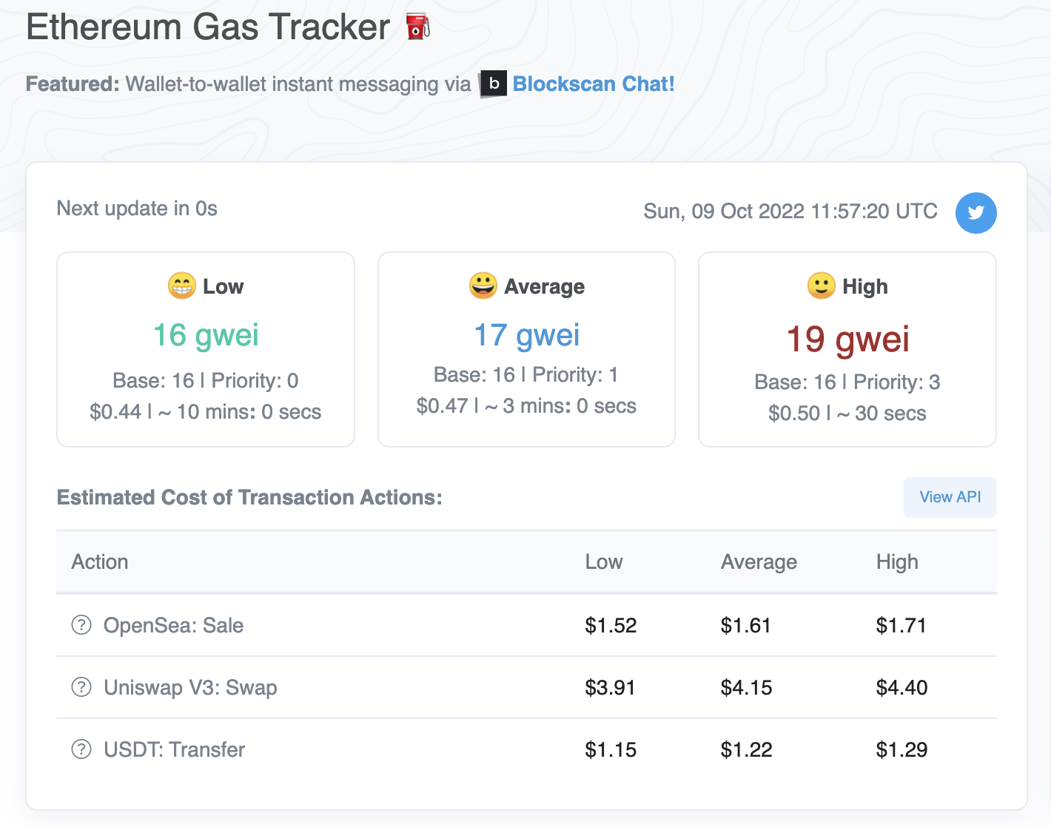
https://etherscan.io/gastracker
Vitalik Buterin, co-founder of Ethereum, believes Ethereum will be able to process close to 1,00,000 transactions per second. At present, it can do 25 per second.
The next stage is sharding, a process to reduce network congestion and increase transaction speed.
Sharding will create 64 different shards so that the information of the blockchain is split up.
Notes:
https://etherscan.io/gastracker

Slide 14
Ethereum for Applications
Ethereum will completely transform applications of all shapes and sizes.
With a built-in scripting language and distributed virtual machine, smart contracts can be built to carry out all sorts of functions without the need for a trusted third party or central authority.
Using its internal cryptocurrency, ether, nodes can be paid for their processing power in running these decentralized apps, and entire decentralized autonomous organizations (DOAs) will exist in an ether economy.

Slide 15
What is a Dapp?
A dapp has its backend code running on a decentralized peer-to-peer network. Contrast this with an app where the backend code is running on centralized servers.
A decentralized application (dapp) is an application built on a decentralized network that combines a smart contract and a frontend user interface.
On Ethereum, smart contracts are accessible and transparent – like open APIs – so your dapp can even include a smart contract that someone else has written.

Slide 16
Ethereum for DeFi
Ethereum has given rise to a new constellation of “decentralized finance” or DeFi businesses and projects.
Essentially the cryptocurrency version of Wall Street, DeFi aims to offer people access to financial services—borrowing, lending, and trading—without the need for legacy institutions such as banks and brokerages, which often take large commissions and other fees.
Most DeFi apps are built on the Ethereum blockchain.
Ethereum has a range of potential applications beyond cryptocurrency, experts say, such as facilitating real estate deals and international trade.

Slide 17
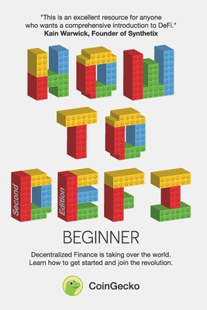
Summary From ‘How To DeFi (Beginner)’ Book
https://blog.cryptostars.is/summary-from-how-to-defi-beginner-book-by-coingecko-23e0c001e0ad

Slide 18
8 DeFi Key Categories
Stablecoins
Lending & Borrowing
Exchanges
Derivatives
Fund Management
Lottery
Payments
Insurance

Slide 19
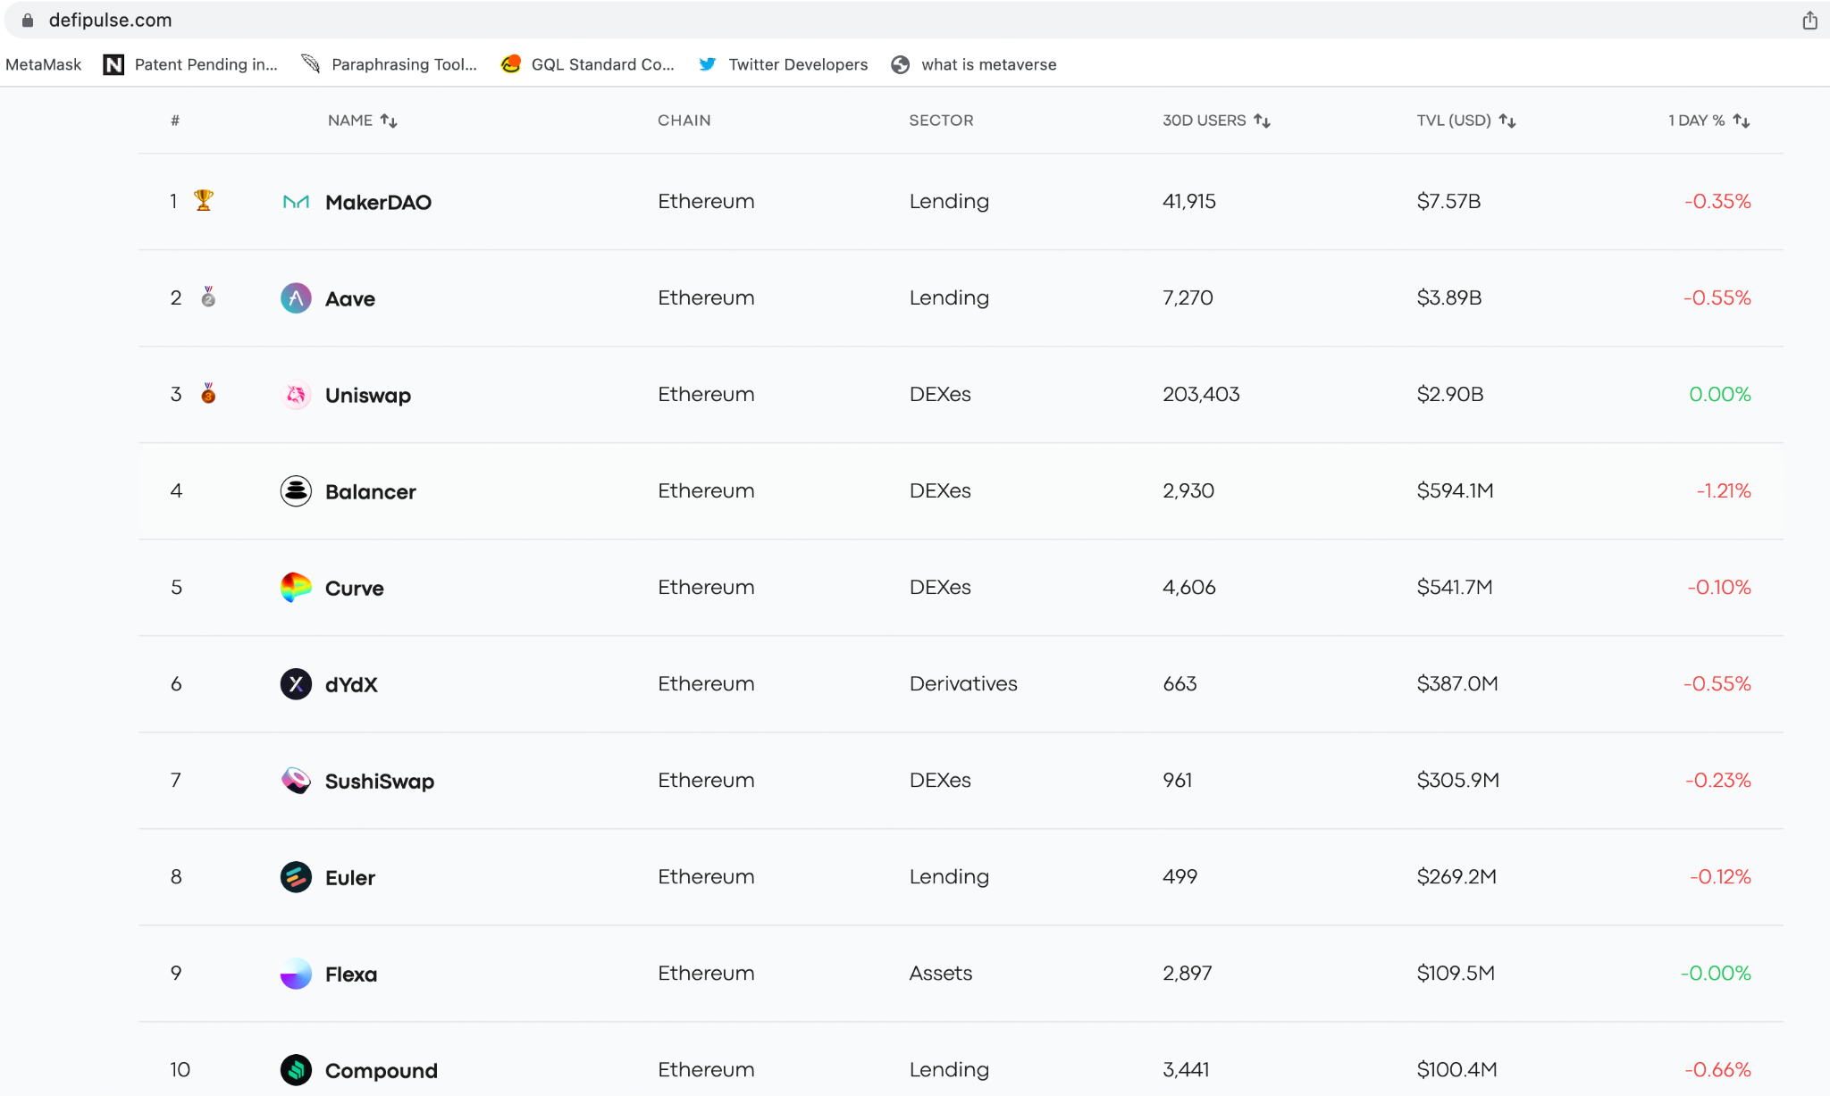
Notes:
https://www.defipulse.com/

Slide 20
Ethereum for Global Trade and Commerce
International trade is a $16 trillion market that accounts for the exchange of capital, goods, and services across international borders or territories.
Major trading companies around the world are recognizing the transformative impact of Ethereum blockchain technology in operating global supply chains, managing trade finance, and unlocking new business models.

Slide 21
REAL ESTATE ASSET TOKENIZATION
Real estate is the world’s most significant store of wealth. The total value of all the world’s real estate stands at USD 327 trillion, a record high. To put that into context, the value of all gold ever mined pales by comparison at USD 12.1 trillion — just 4% of the value of global property.
Tokenization of commercial real estate transactions will reduce transaction costs from 30% to 2%, entry barriers for investors from $200,000 to $100 and reduce the time for conducting operations from 1 month to 1 click.
Asset Fractionalisation is the simple process of dividing an asset into smaller denominations so that many users can buy its partial ownership.
We can apply to Assets such as art, precious metals, real estate, private equity or debt positions, etc.
https://github.com/panacloud-modern-global-apps/defi-dapps-solidity-smart-contracts/tree/main/step20_real_estate_tokenization

Slide 22
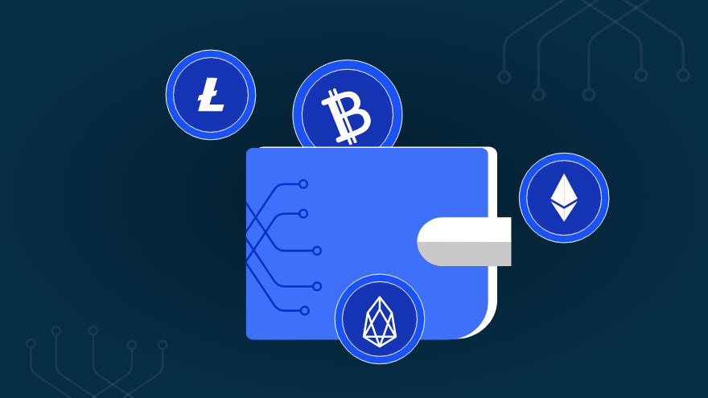
What is a Crypto Wallet?
Crypto wallets keep your private keys – the passwords that give you access to your cryptocurrencies – safe and accessible, allowing you allow you to send, receive, and spend cryptocurrencies like Ethereum and ERC-20 Tokens.

Slide 23

What is MetaMask?
MetaMask is a cryptocurrency wallet that enables users to access the Web 3 ecosystem of decentralized applications (dapps). It also enables users to store Ether and other ERC-20 tokens.
Notes:
https://decrypt.co/resources/metamask

Slide 24

Goerli Testnet
It is named after a train station in Berlin and is one of the largest and most active
Ethereum test nets.
https://www.definitions.net/pronounce/Goerli

Slide 25
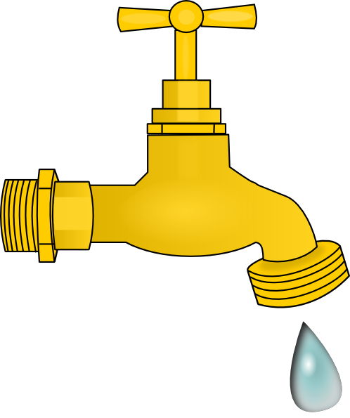
What is a Faucet?
Few developers want to spend real money when testing or deploying smart contracts. That’s why testnet faucets are the ideal solution – you get free cryptocurrencies you can use to pay gas when deploying or testing smart contracts.

Slide 26
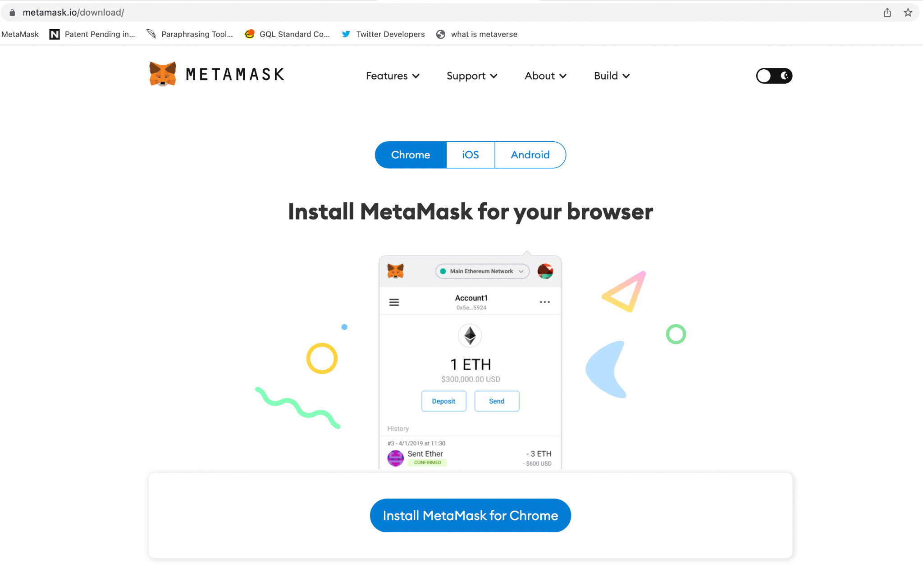
Notes:
https://metamask.io/download/

Slide 27
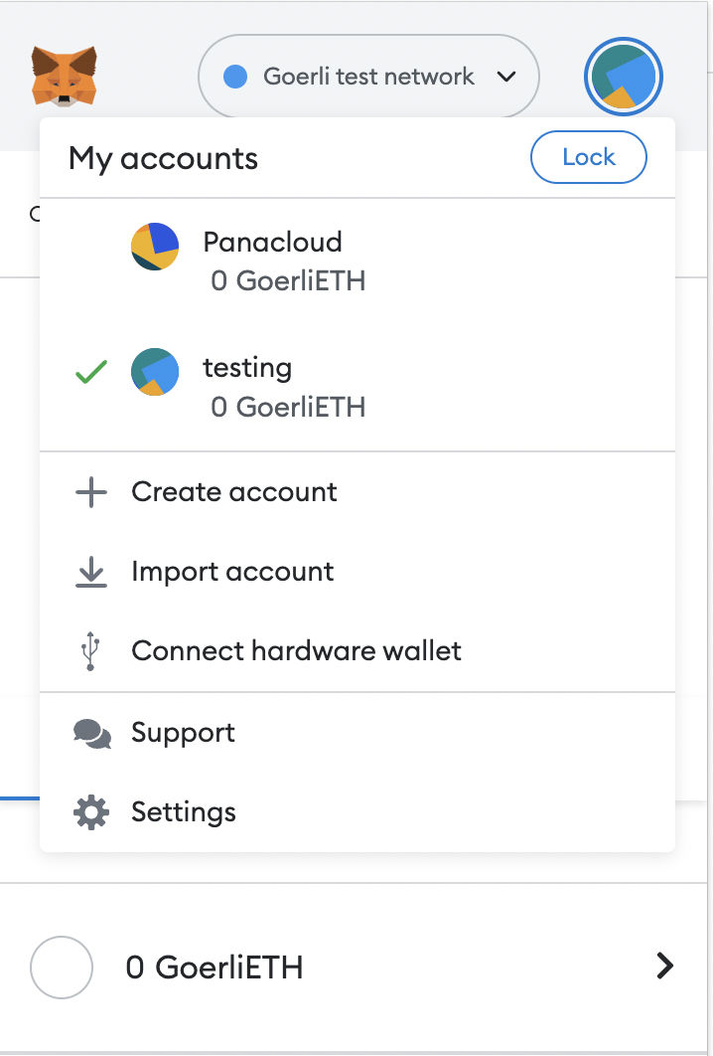
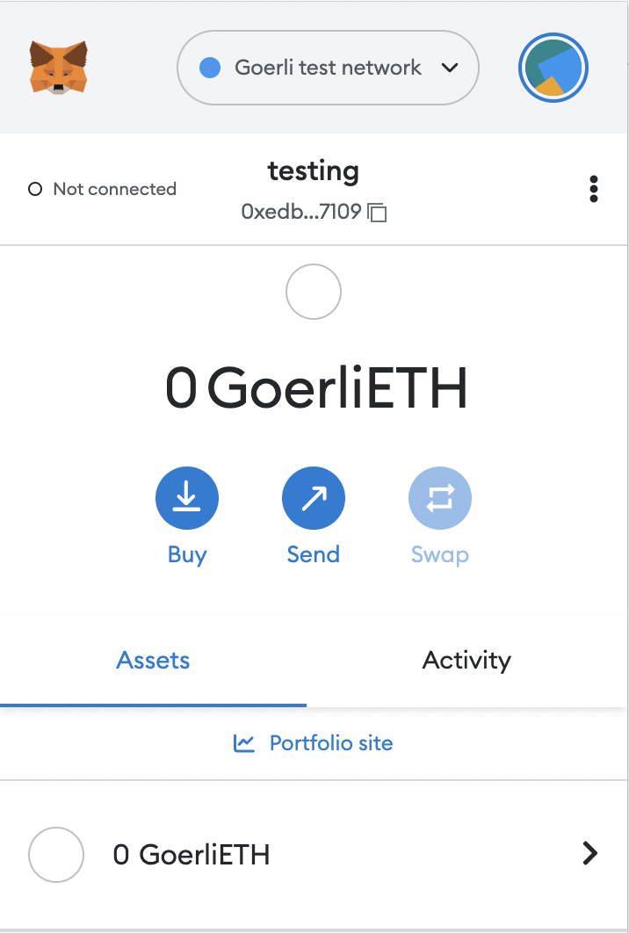
Change to Goerli Test Network
Create a testing account
Copy Your Wallet Address

Slide 28
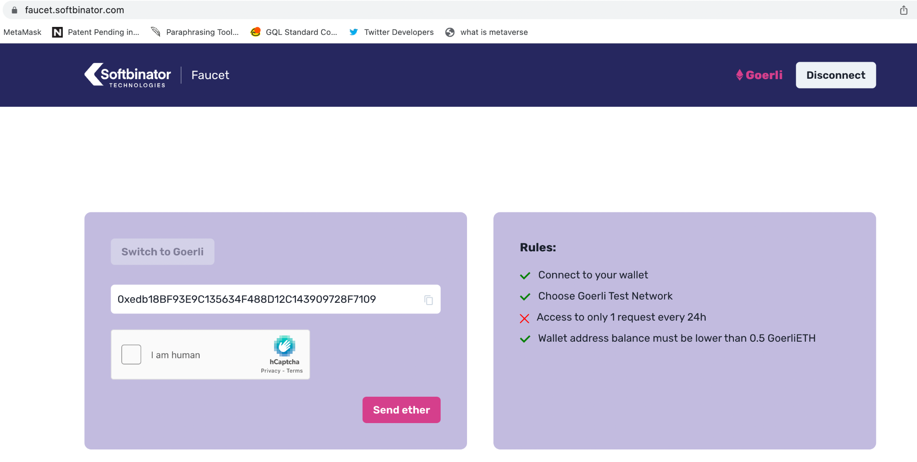
Notes:
https://faucet.softbinator.com/
This is another faucet.

Slide 29
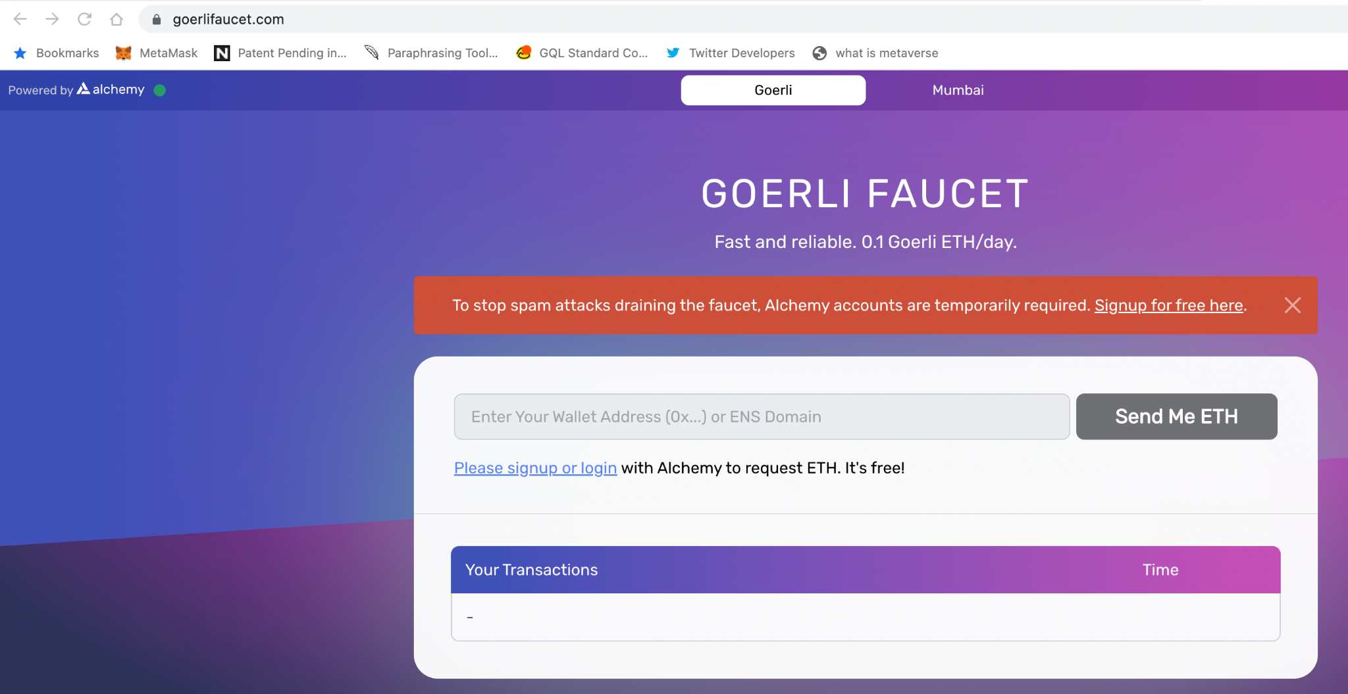
Notes:
https://goerlifaucet.com/

Slide 30
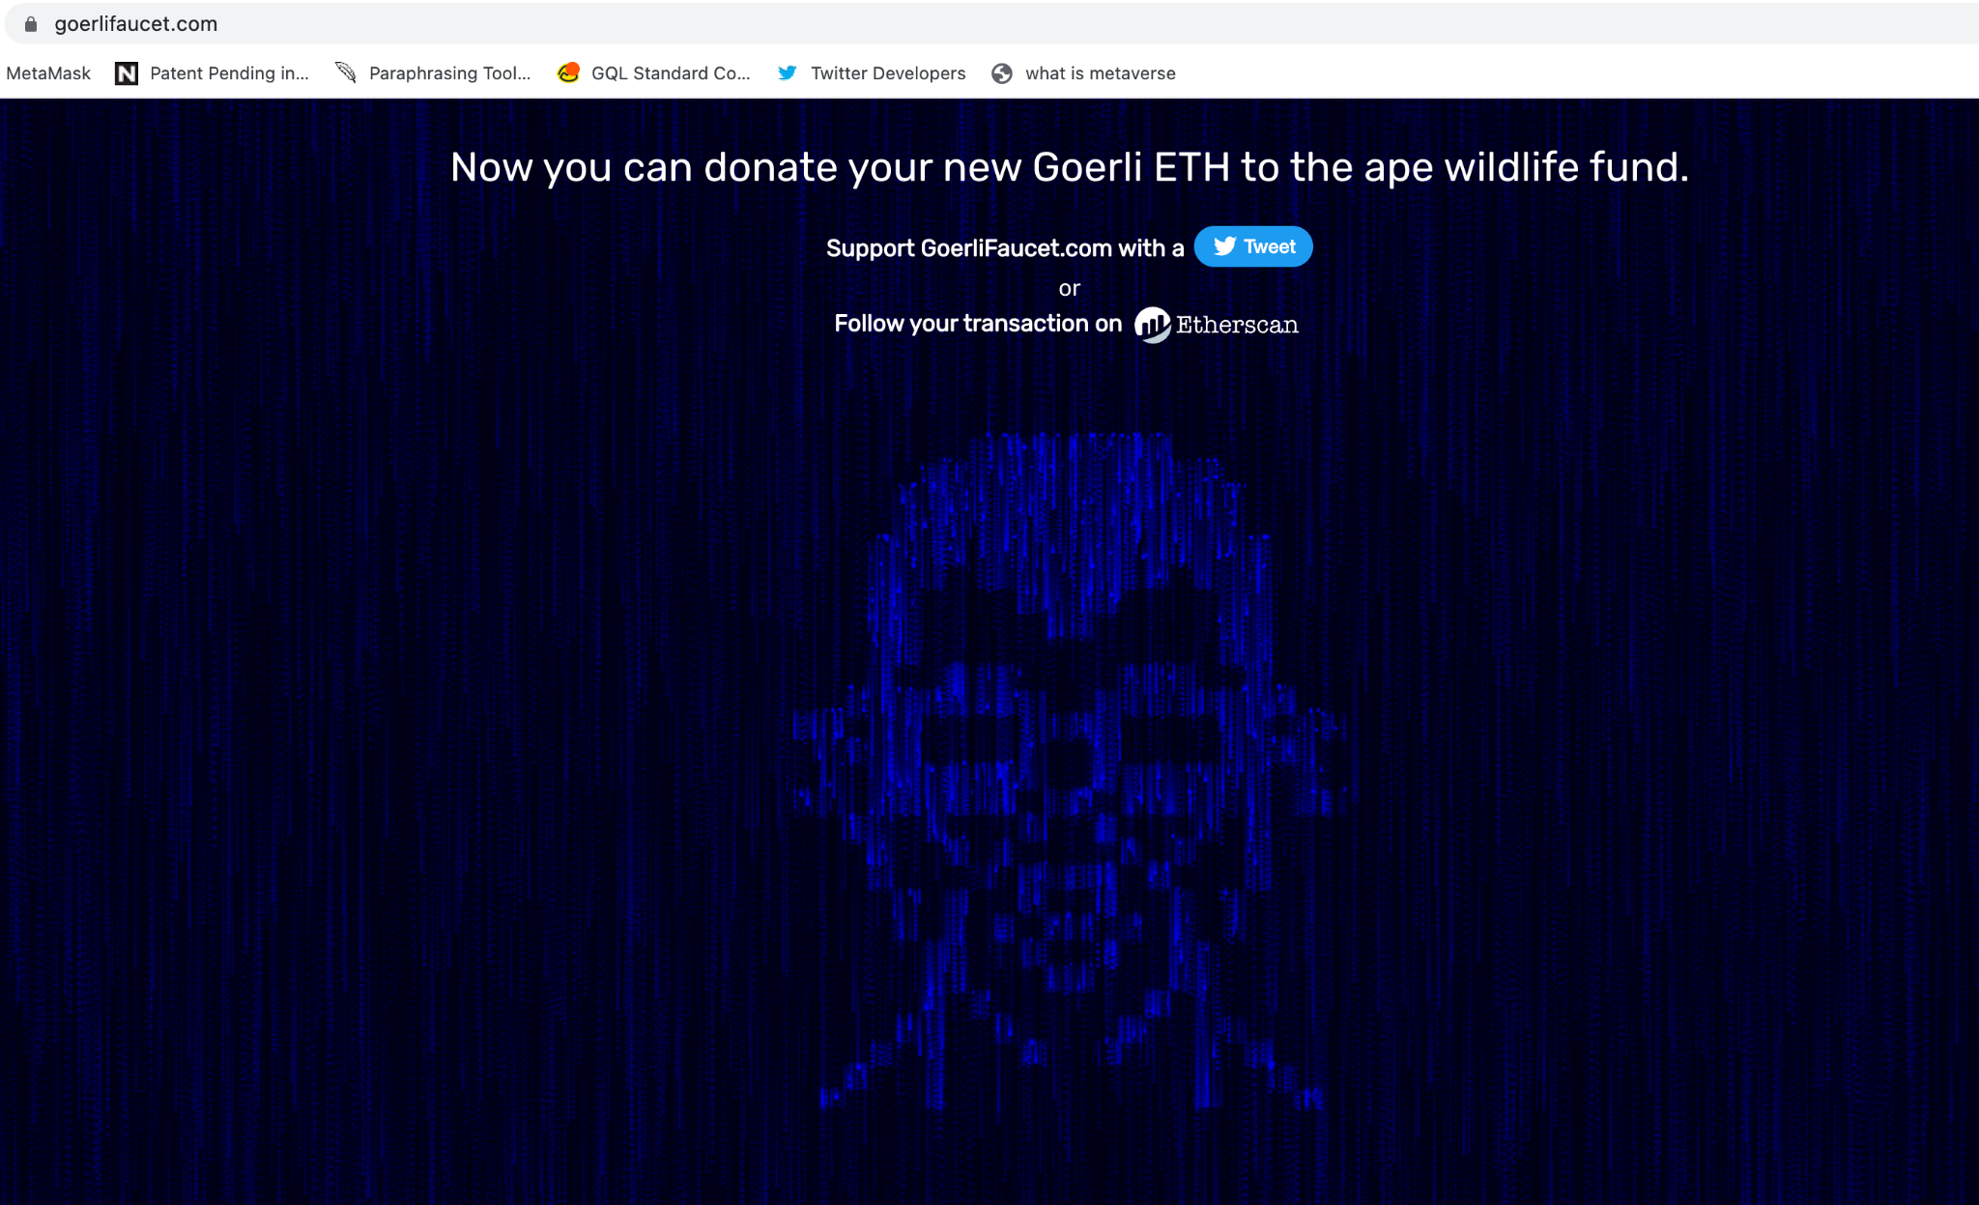

Slide 31
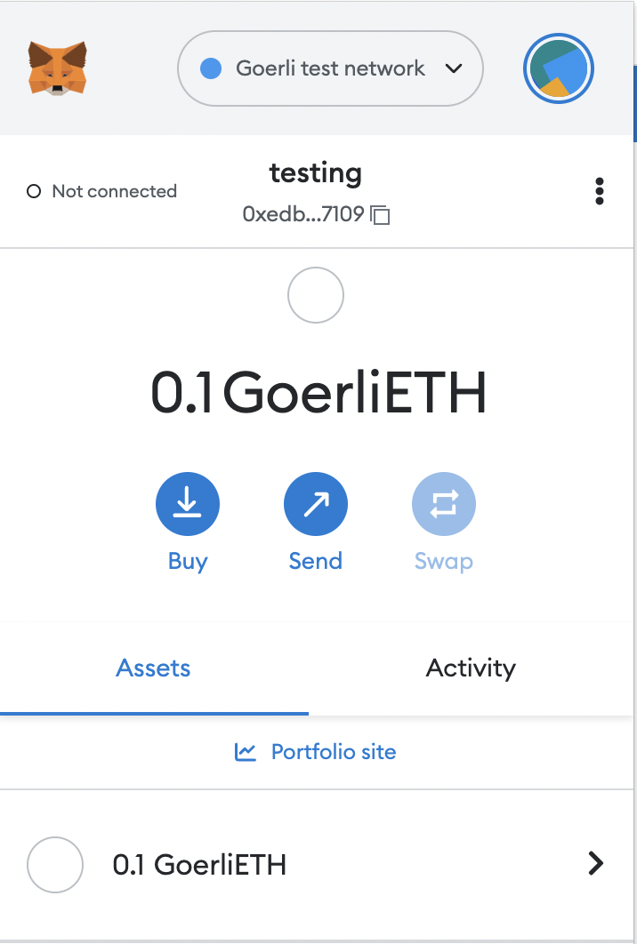

Slide 32

What is a Etherscan?
Etherscan, an Ethereum blockchain explorer, allows you to search the Ethereum blockchain for free.
Through the tool, you can see records of past transactions, smart contracts, wallets, gas fees, and other information related to the Ethereum network.

Slide 33
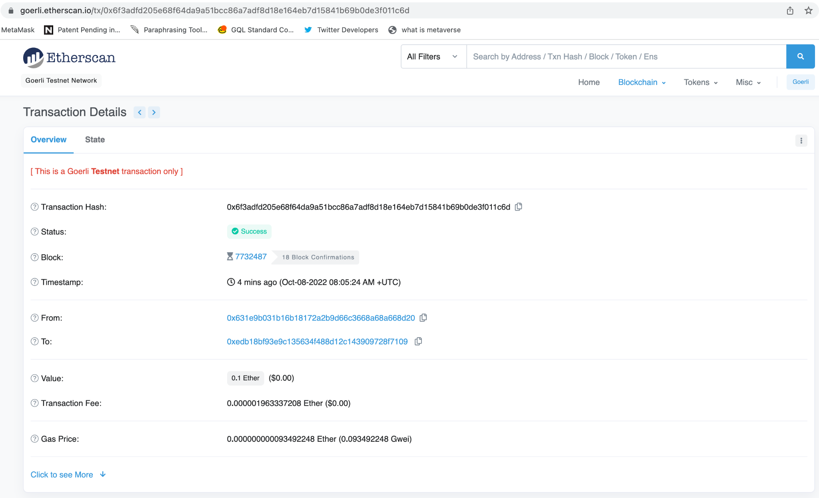

Slide 34

What is Uniswap?
Uniswap is the largest decentralized exchange (or DEX) operating on the Ethereum blockchain.
It allows users anywhere in the world to trade crypto without an intermediary.
UNI, the governance token that allows users to vote on key protocol changes.
Uniswap was one of the first decentralized finance (or DeFi) applications to gain significant traction on Ethereum — launching in November 2018.
Numerous other decentralized exchanges have launched (including Curve, SushiSwap, and Balancer), but Uniswap is currently the most popular by a significant margin.
Uniswap pioneered the Automated Market Maker model, in which users supply Ethereum tokens to Uniswap “liquidity pools” and algorithms set market prices (as opposed to order books, which match bids and asks on a centralized exchange like Coinbase) based on supply and demand.
By supplying tokens to Uniswap liquidity pools, users can earn rewards while enabling peer-to-peer trading.
Anyone, anywhere, can supply tokens to liquidity pools, trade tokens, or even create and list their own tokens (using Ethereum’s ERC-20 protocol).

Slide 35
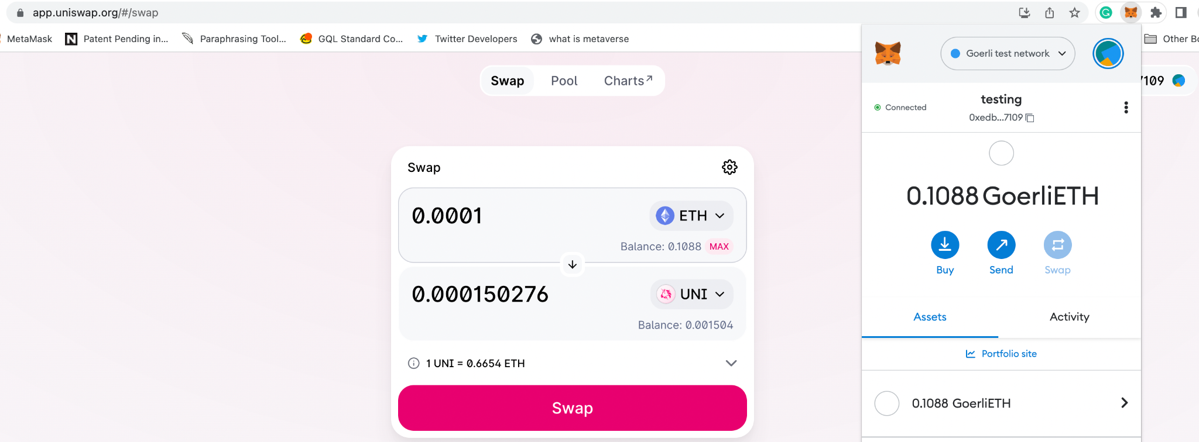
Notes:
You can buy it from uniswap, get some ETH from a faucet like https://faucet.paradigm.xyz/ and use it to swap for UNI using the goerli testnet on uniswap.

Slide 36
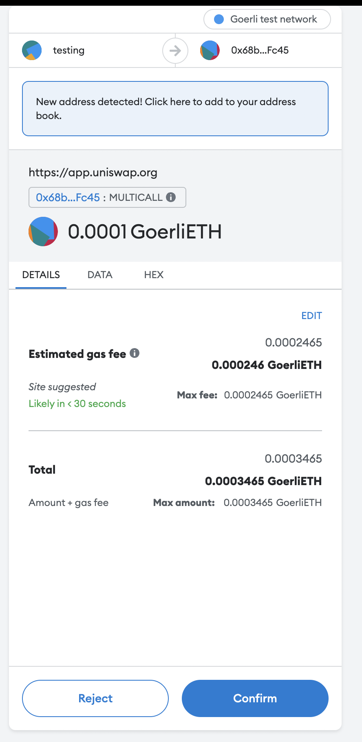
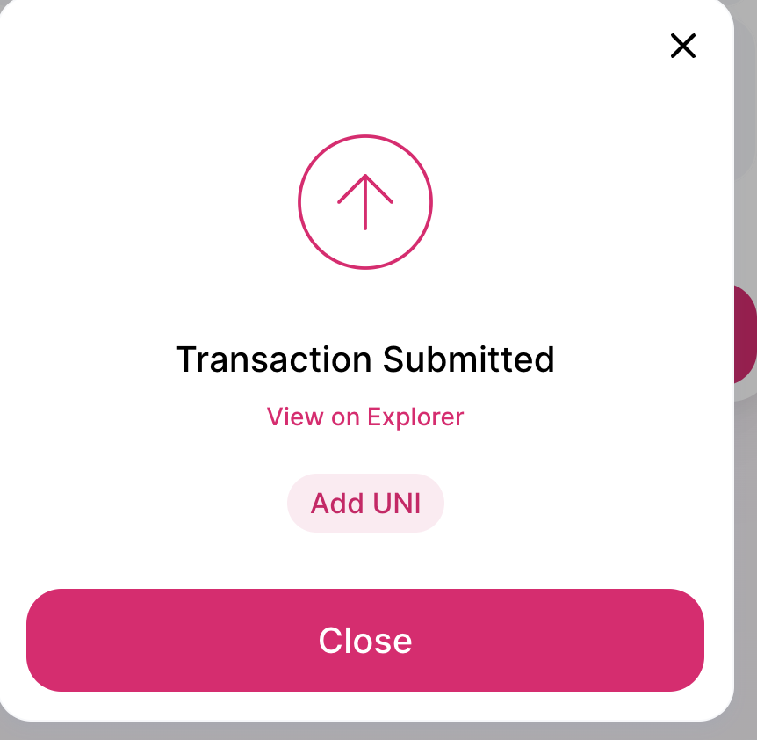

Slide 37
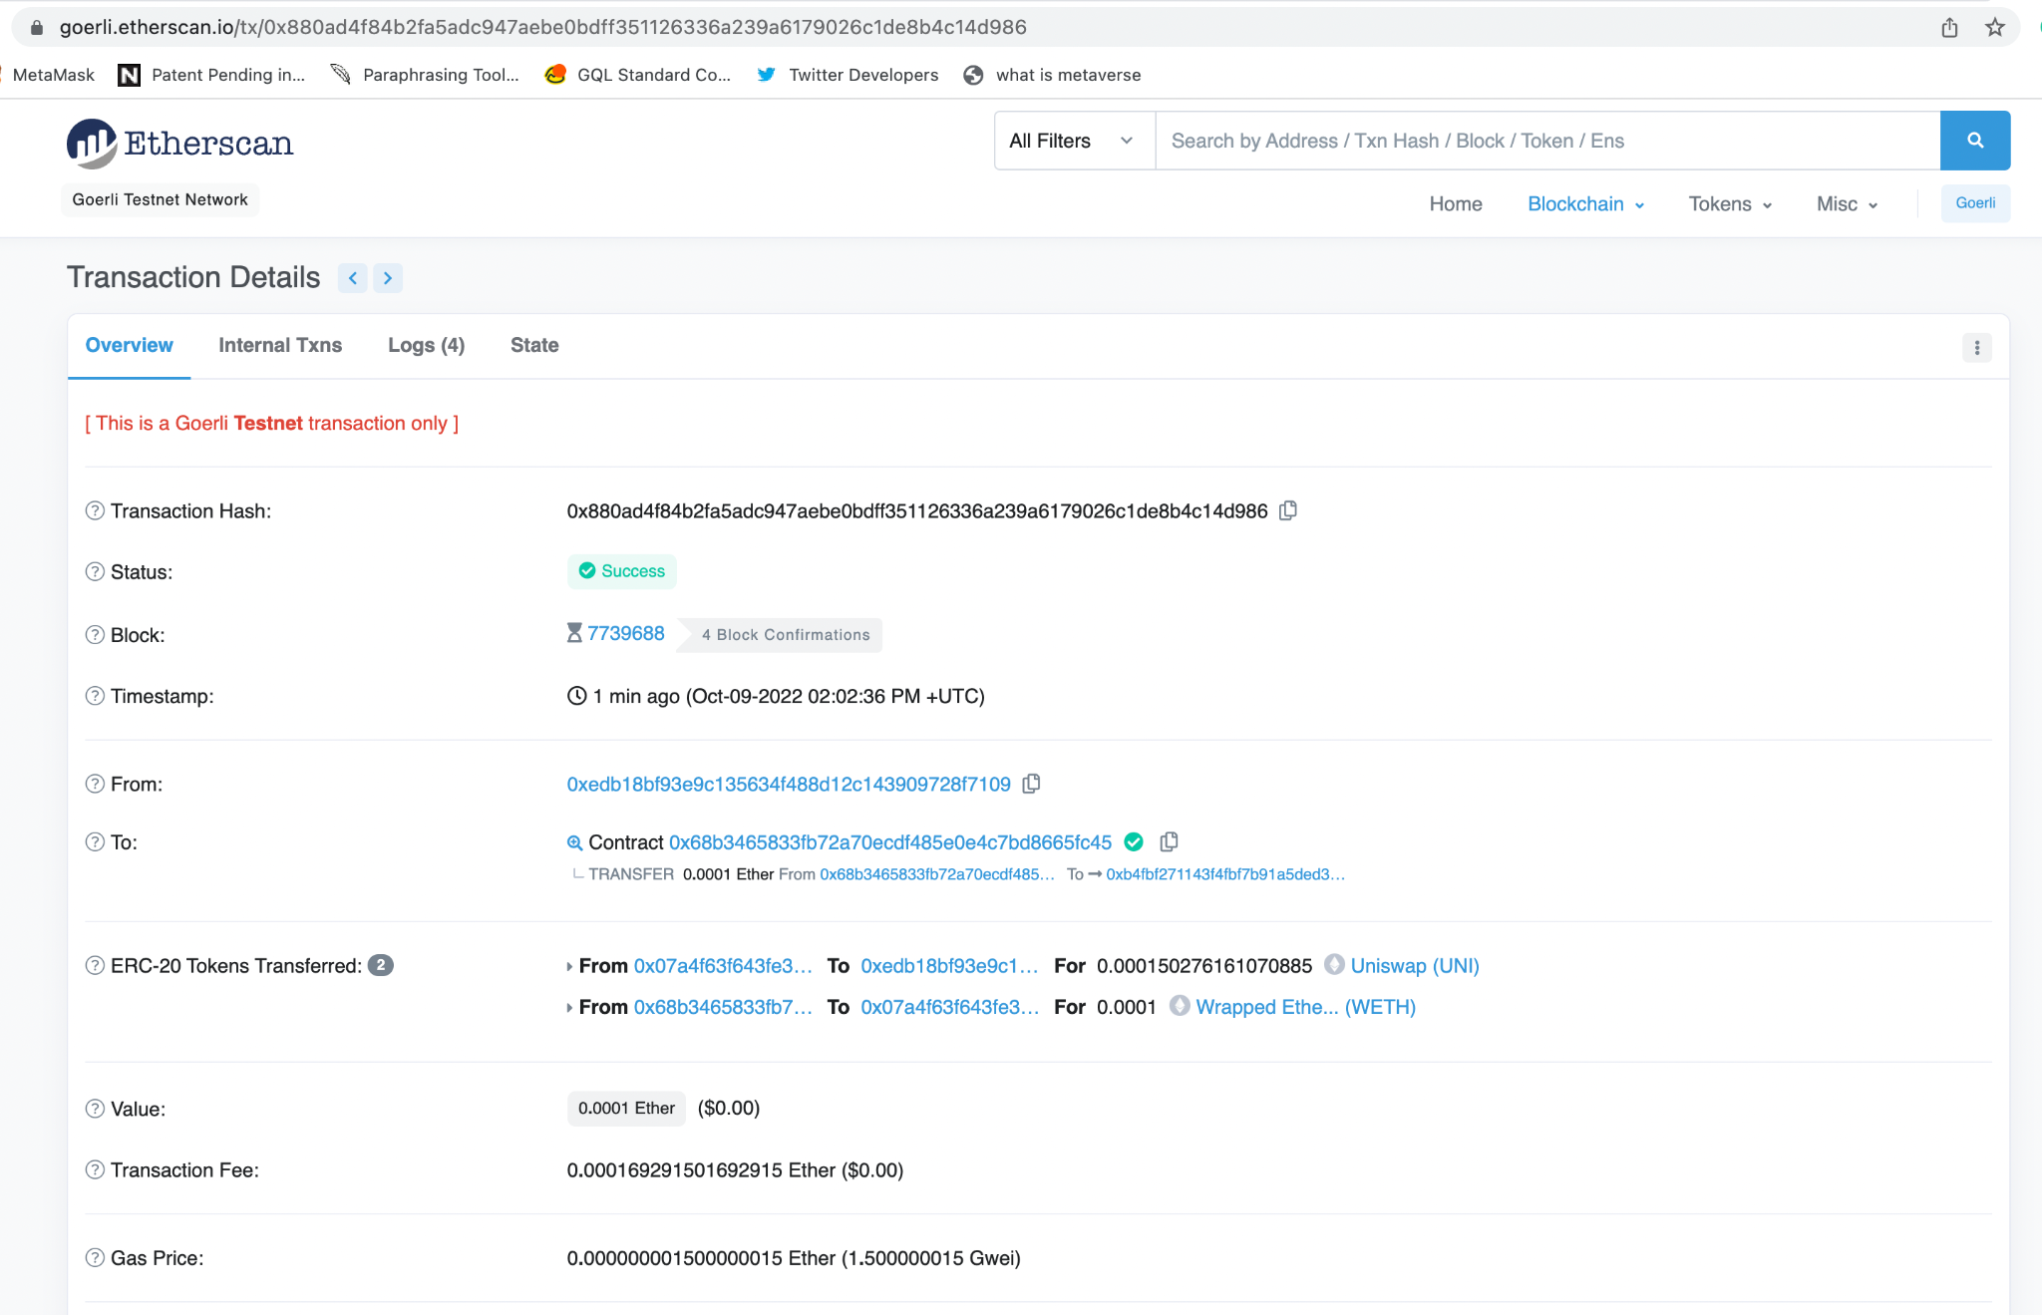

Slide 38
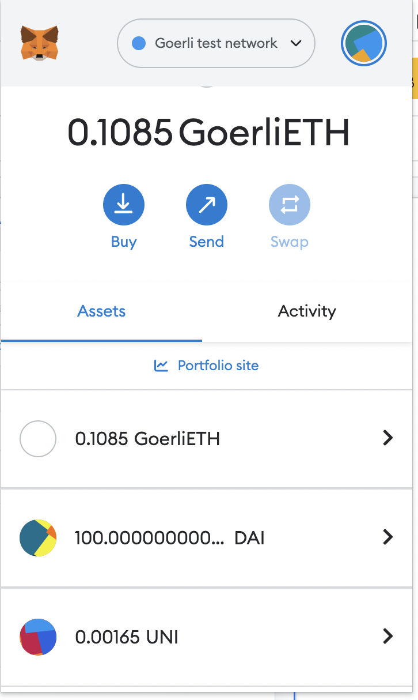

Slide 39
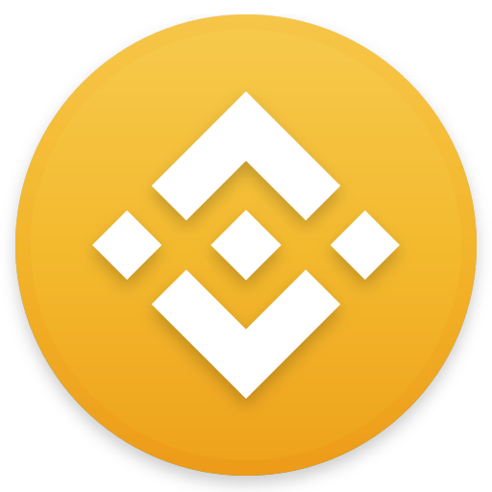
What is Binance?
Binance is an online exchange where users can trade cryptocurrencies. It supports most commonly traded cryptocurrencies.
Binance is a cryptocurrency exchange with the highest liquidity, and Uniswap can be considered its decentralized equivalent.
Binance provides a crypto wallet for traders to store their electronic funds.
The exchange also has supporting services for users to earn interest or transact using cryptocurrencies.
Users can buy, sell, and trade crypto, choose options and futures trading, apply for crypto loans, earn passive income and more with a single login. These centralized products are easy-to-use and comprehend, and can be accessed using a web browser, desktop or mobile app.

Slide 40
Uniswap vs Binance?
Uniswap v3 is the the largest decentralized exchange by trading volume, with more than $1.7 billion worth of assets changing hands in 24 hours, according to data from Coingecko.
However, Binance is the largest centralized crypto exchange with $22.2 billion in trading volume over the same period. Coinbase, meanwhile, logged $3.1 billion.
Uniswap has four fee tiers: 0.01%, 0.05%, 0.30% and 1.00%. Depending on the pair you trade, you could be charged as low as a 0.01% fee or as high as a 1% fee.
Stablecoin pairs like USDC/USDT on Uniswap have usually low fees while altcoin pairs tend to have higher fees, which you can check out on Uniswap’s overview page.
Binance, on the other hand, has very low trading fees starting from 0.10%.
The research used a metric called market depth to compare liquidity across Uniswap v3 and the centralized exchanges. Market depth, a common method used to measure liquidity on exchanges, shows how much of one asset can be traded for another at a given price level. For an Ether/USD trading pair, a trader who executes a single $5-million trade can save about $24,000 on Uniswap v3 compared with Coinbase, according the research.
Notes:
https://www.bloomberg.com/news/articles/2022-05-05/defi-exchange-says-it-provides-more-liquidity-than-larger-rivals

Slide 41
How to buy Ethereum in Pakistan
https://www.techjuice.pk/how-to-buy-ethereum-in-pakistan/

Slide 42
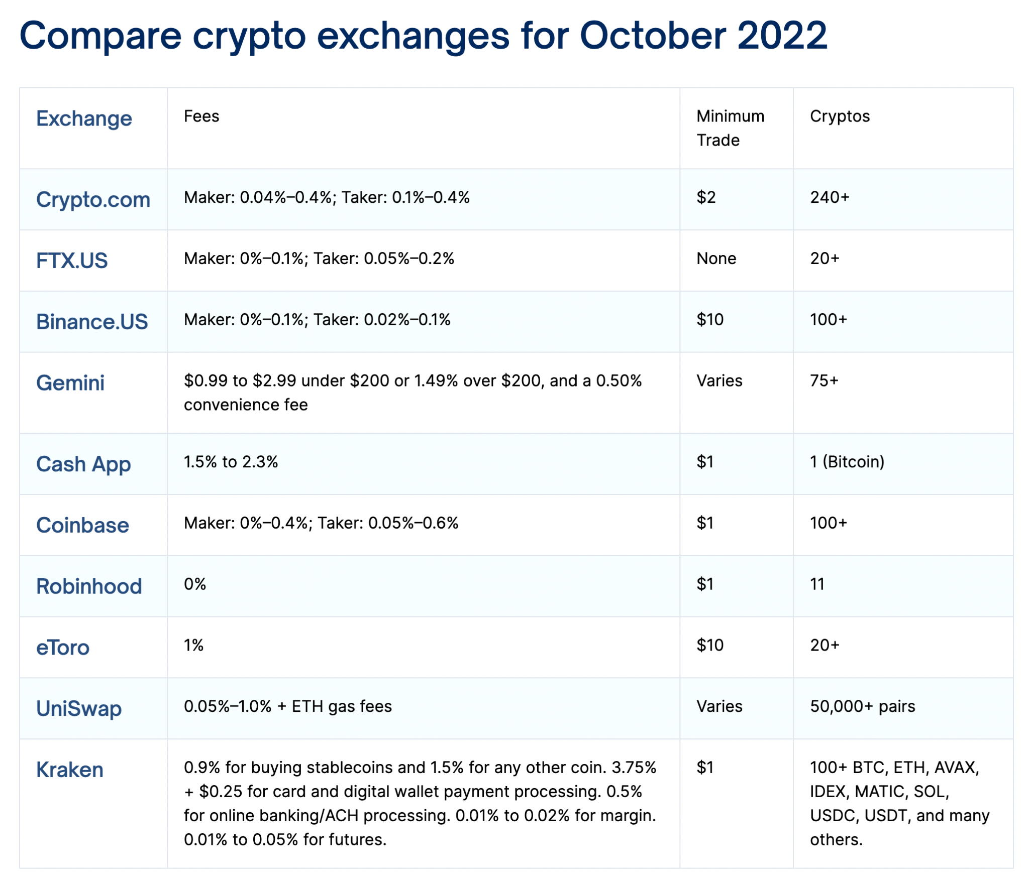
Notes:
https://defirate.com/exchanges

Slide 43
What is ERC-20?
Ethereum Request for Comment 20 (ERC-20) is the implemented standard for fungible tokens created using the Ethereum blockchain. It is the technical standard used in many new tokens created using the Ethereum ecosystem.
A fungible token is one that is interchangeable with another token—where the well-known non-fungible tokens (NFTs) are not interchangeable.
It guides the creation of new tokens on the Ethereum blockchain so that they are interchangeable with other tokens used within smart contracts.
Smart contracts were becoming more popular in 2015, but several issues needed to be addressed. Because anyone could make a token, many were being created. However, there wasn't a way to ensure that all of the different tokens could be created, used, or exchanged.
Without a standardized methodology for tokens, every application would need its own token, and users would need to find a way to convert them back and forth between the hundreds of apps being developed.

Slide 44
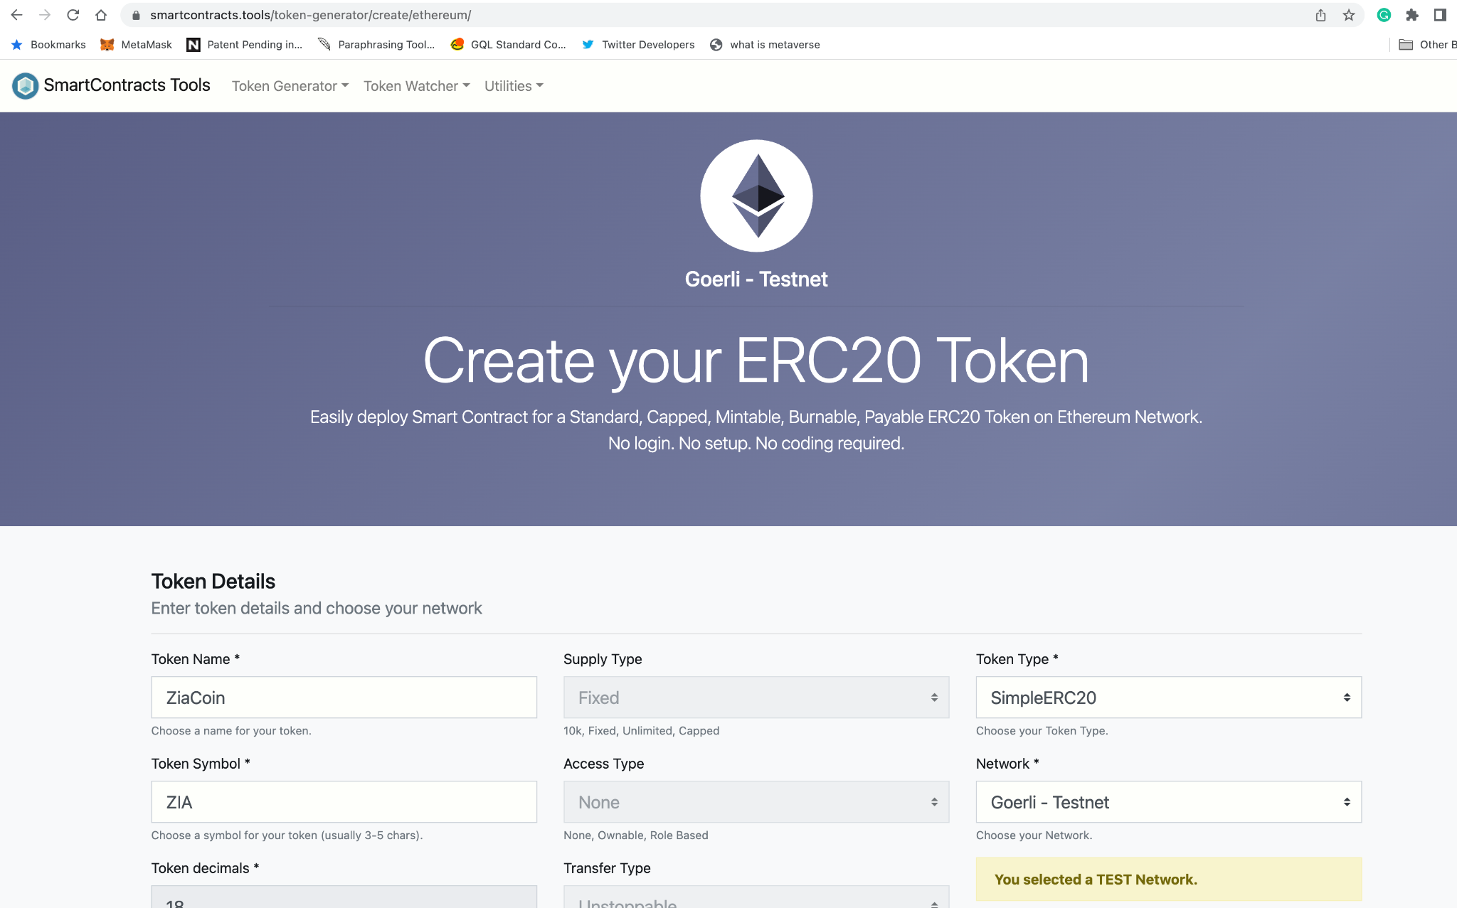
Create Your ERC20 Token
Create your own ERC-20 token using your name on Goerli Testnet e.g. ZiaCoin
https://www.smartcontracts.tools/token-generator/create/ethereum/

Slide 45
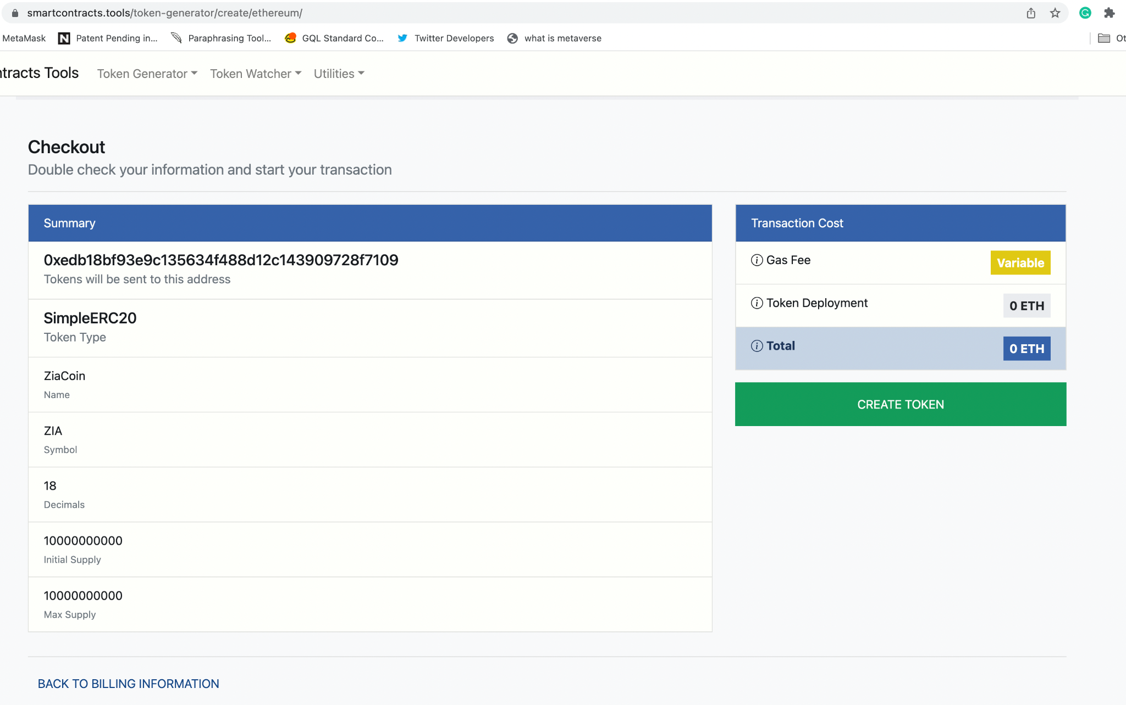

Slide 46
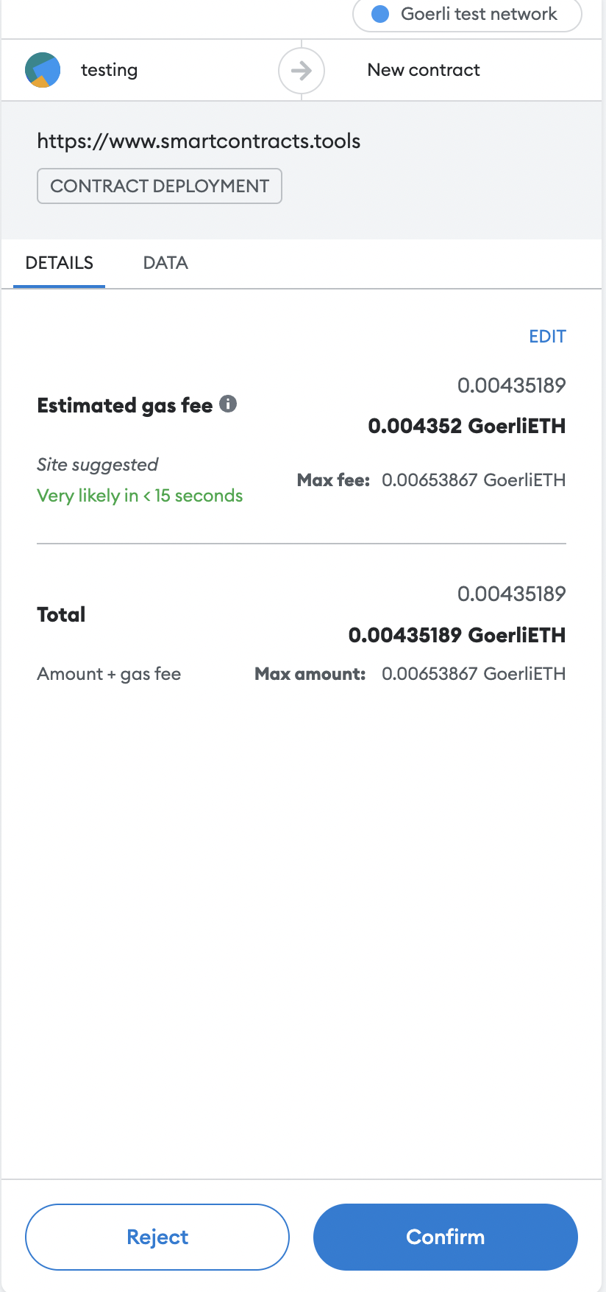
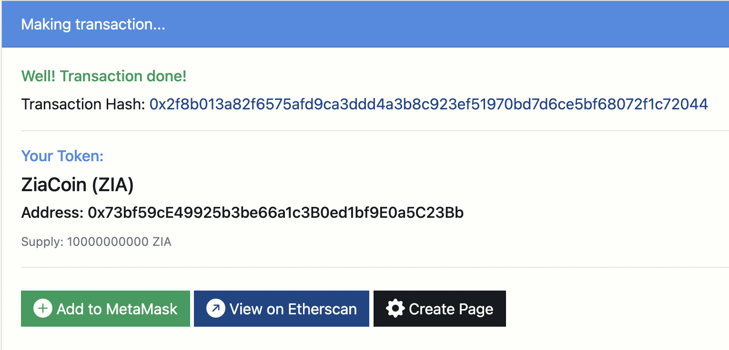
ZiaCoin (ZIA)
Contract Address: 0x73bf59cE49925b3be66a1c3B0ed1bf9E0a5C23Bb
Transaction Hash:
0x2f8b013a82f6575afd9ca3ddd4a3b8c923ef51970bd7d6ce5bf68072f1c72044

Slide 47
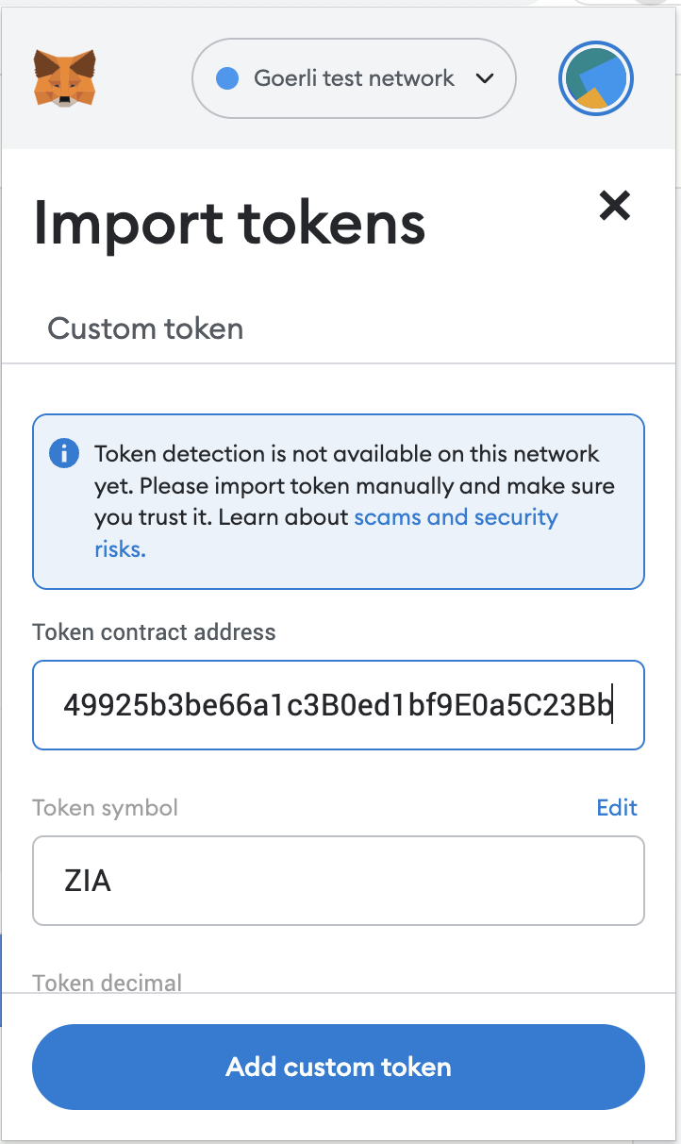
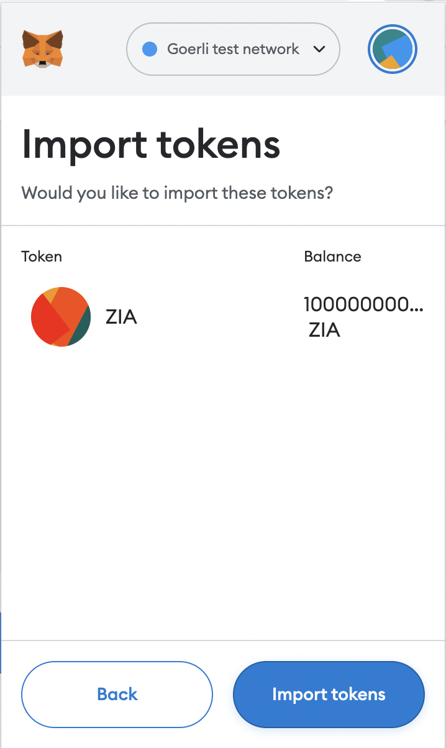
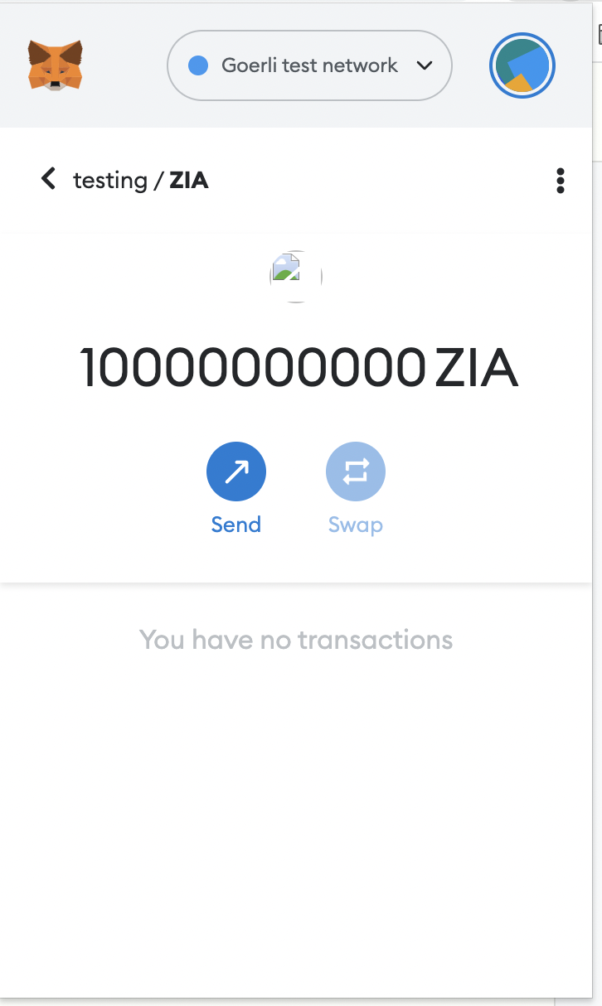
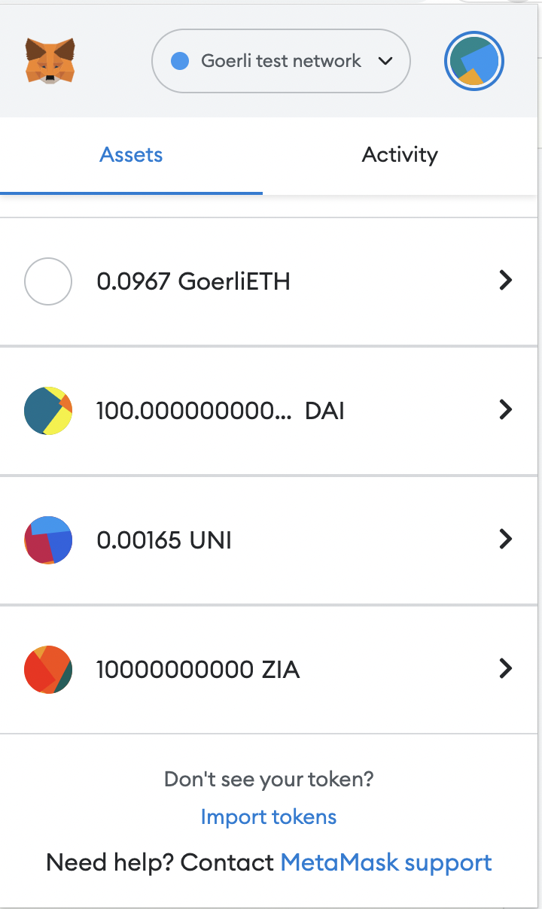
Importing Token in the Metamask Wallet

Slide 48
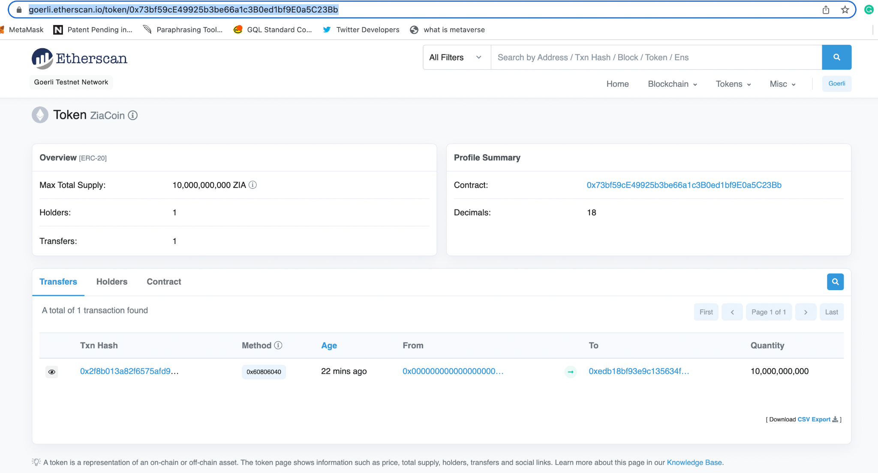

Slide 49
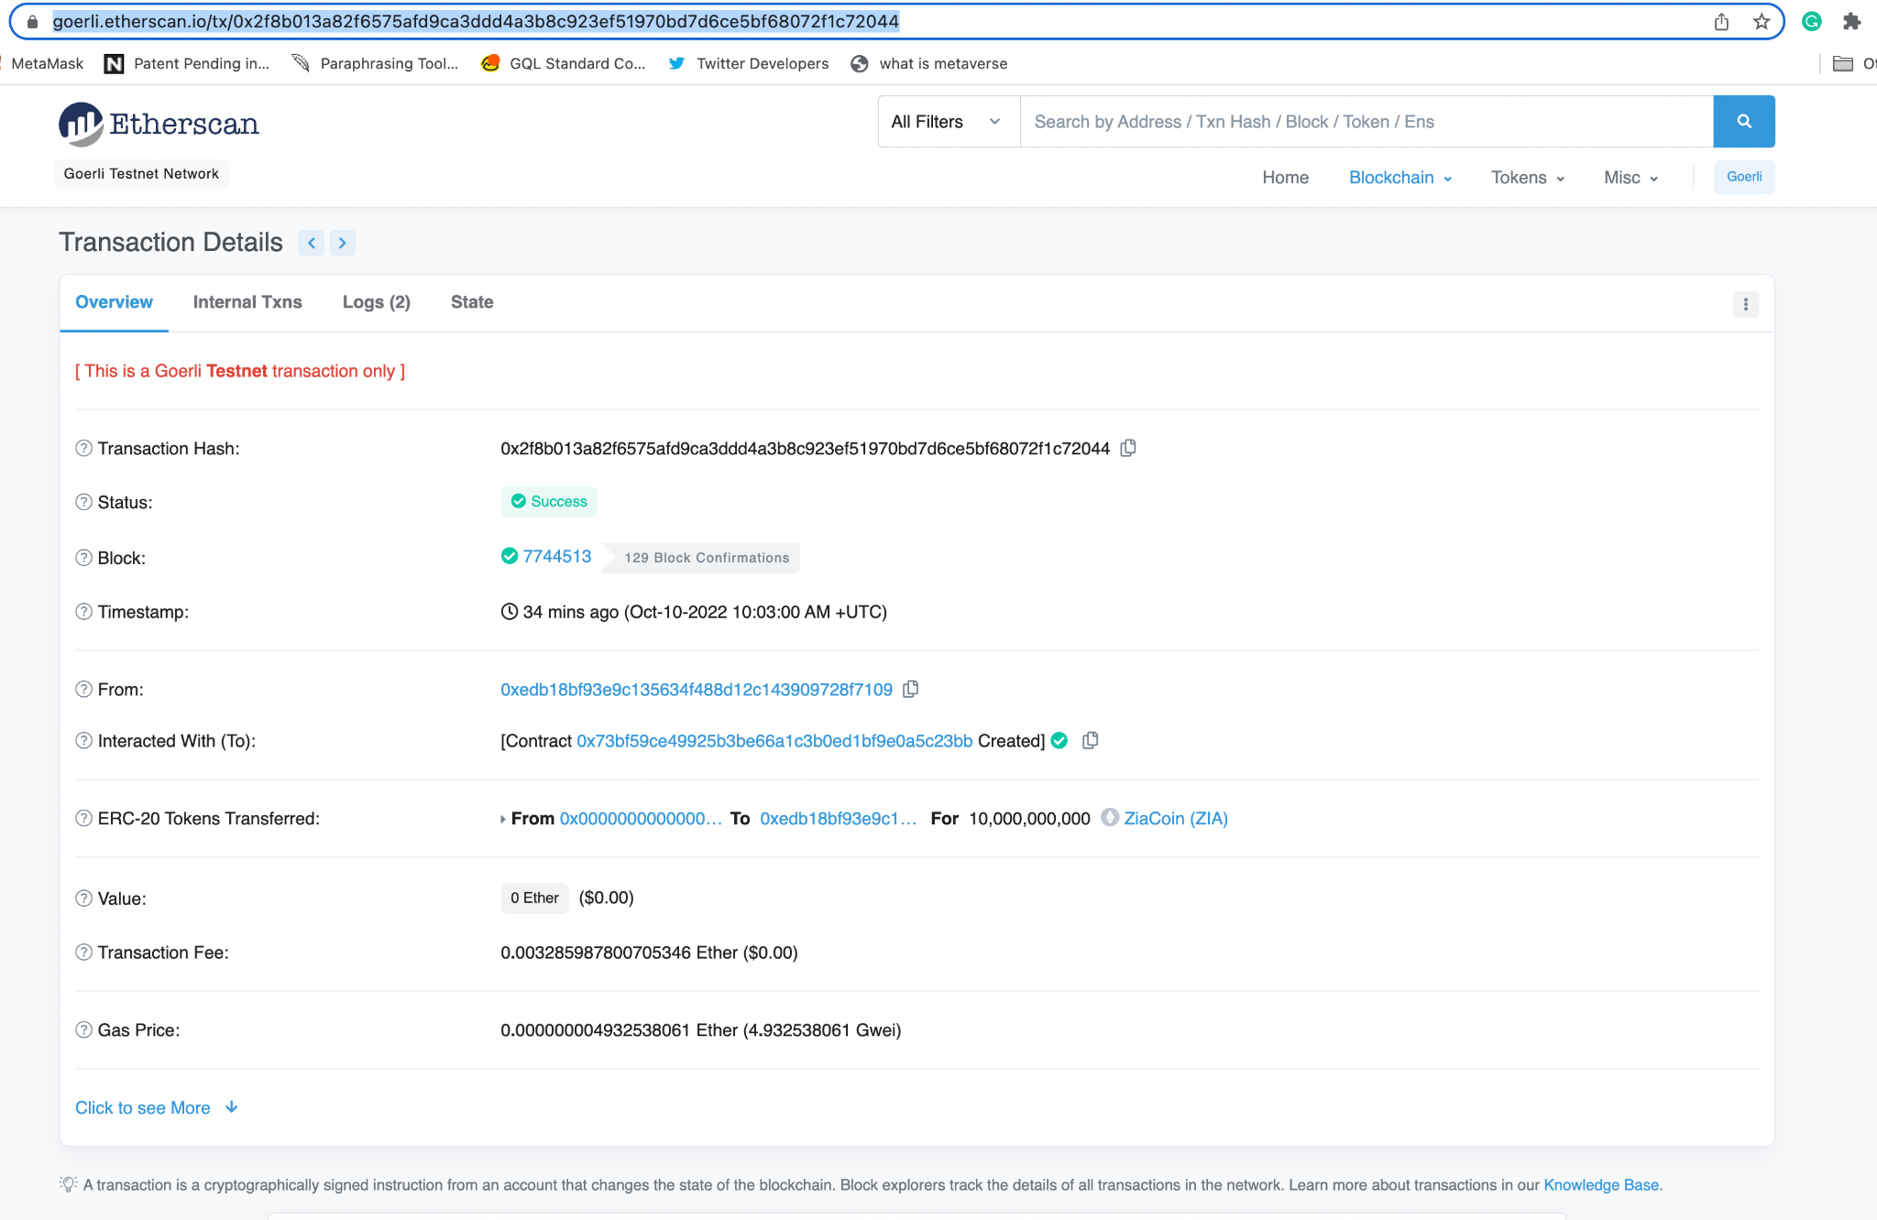

Slide 50
What are NFTs?
Non-fungible tokens (NFTs) are cryptographic assets on a blockchain with unique identification codes and metadata that distinguish them from each other.
Unlike cryptocurrencies, they cannot be traded or exchanged at equivalency. This differs from fungible tokens like cryptocurrencies, which are identical to each other and, therefore, can serve as a medium for commercial transactions.
NFTs (non-fungible tokens) are unique cryptographic tokens that exist on a blockchain and cannot be replicated.
NFTs can represent real-world items like artwork and real estate.
"Tokenizing" these real-world tangible assets makes buying, selling, and trading them more efficient while reducing the probability of fraud.
NFTs can also function to represent individuals' identities, property rights, and more.
Collectors have sought NFTs as their value initially soared, but has since moderated.

Slide 51

What is OpenSea?
The world's first and largest digital marketplace for crypto collectibles and non-fungible tokens (NFTs). Buy, sell, and discover exclusive digital items.
Is the first ever decentralized NFT marketplace built on the Ethereum blockchain and is currently the largest.
OpenSea is a regionalized peer-based marketplace for trading rare and unique digital assets.
Whether it’s collectibles, arts, or gaming items developed on NFT (non-fungible token) technology and flow on the blockchain of Ethereum, an investor can buy, sell, and trade these on OpenSea.
platform has over 1 million users in 2022.
It has recently entered the Alexa 500 Most Visited Websites, with a total of 121.7 million views.
Over 80 million different types of NFTs are available for trade on OpenSea.
Over 80% of the free NFTs created on OpenSea are either fraudulent or spam.
Notes:
https://earthweb.com/opensea-statistics/

Slide 52
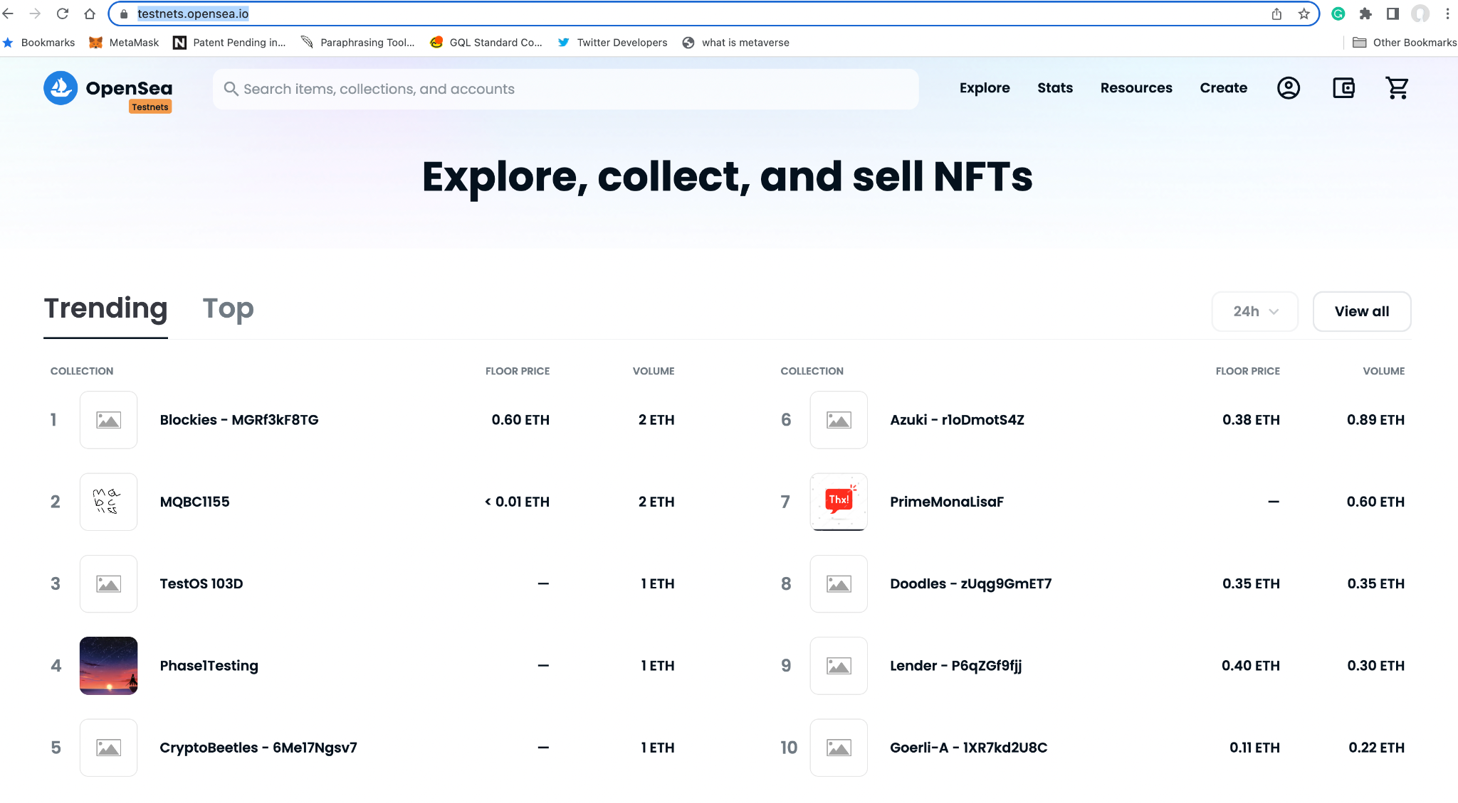
Notes:
https://testnets.opensea.io/

Slide 53
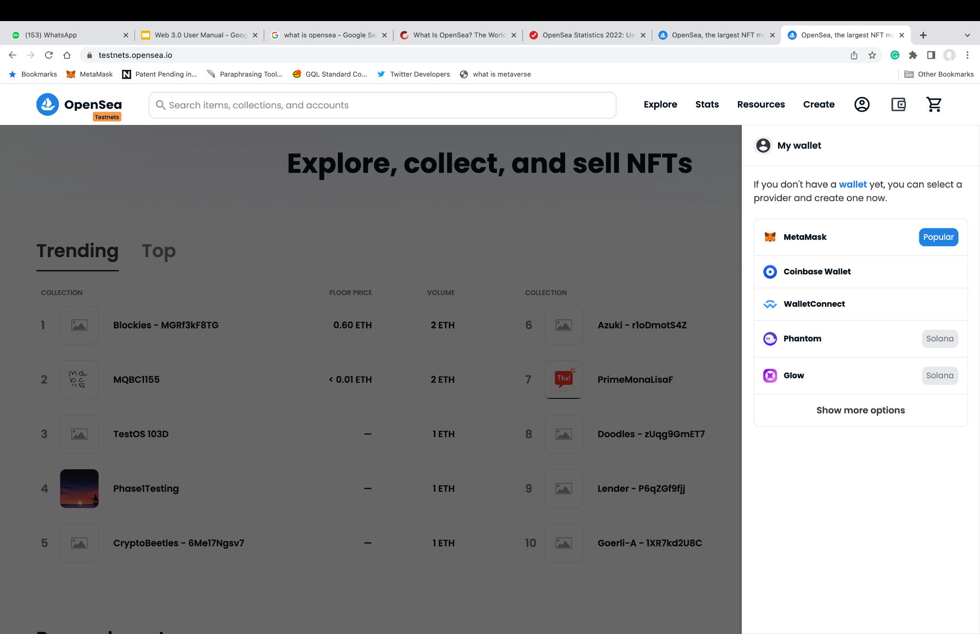

Slide 54
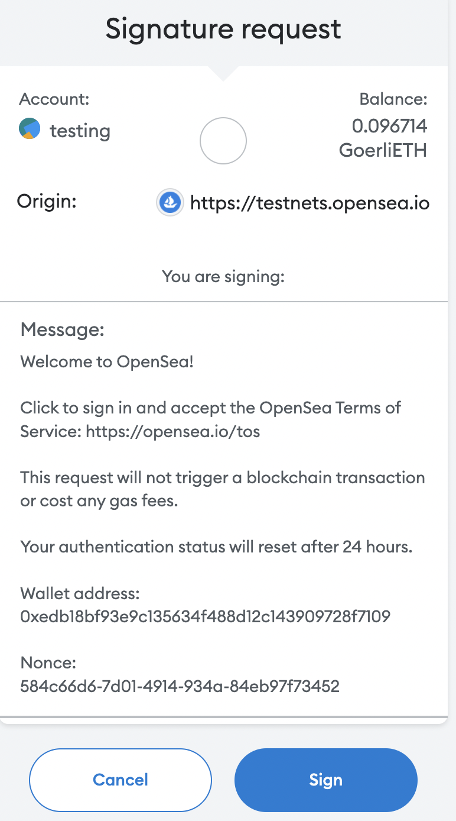

Slide 55
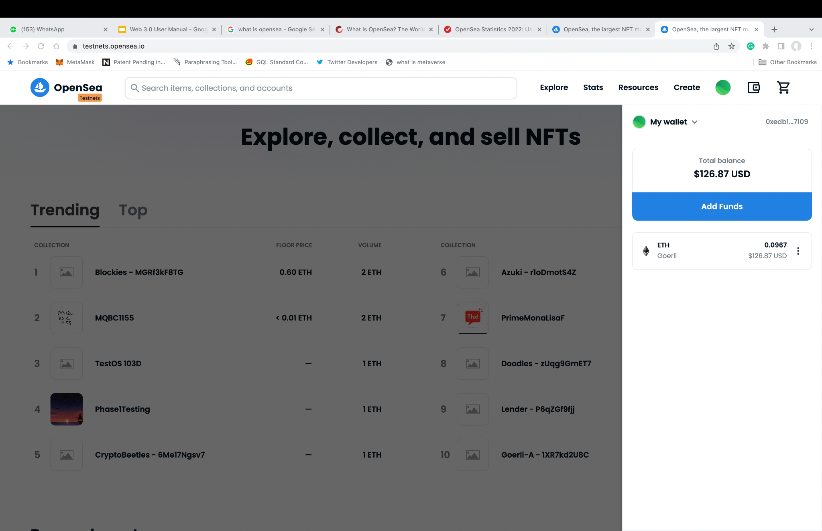

Slide 56
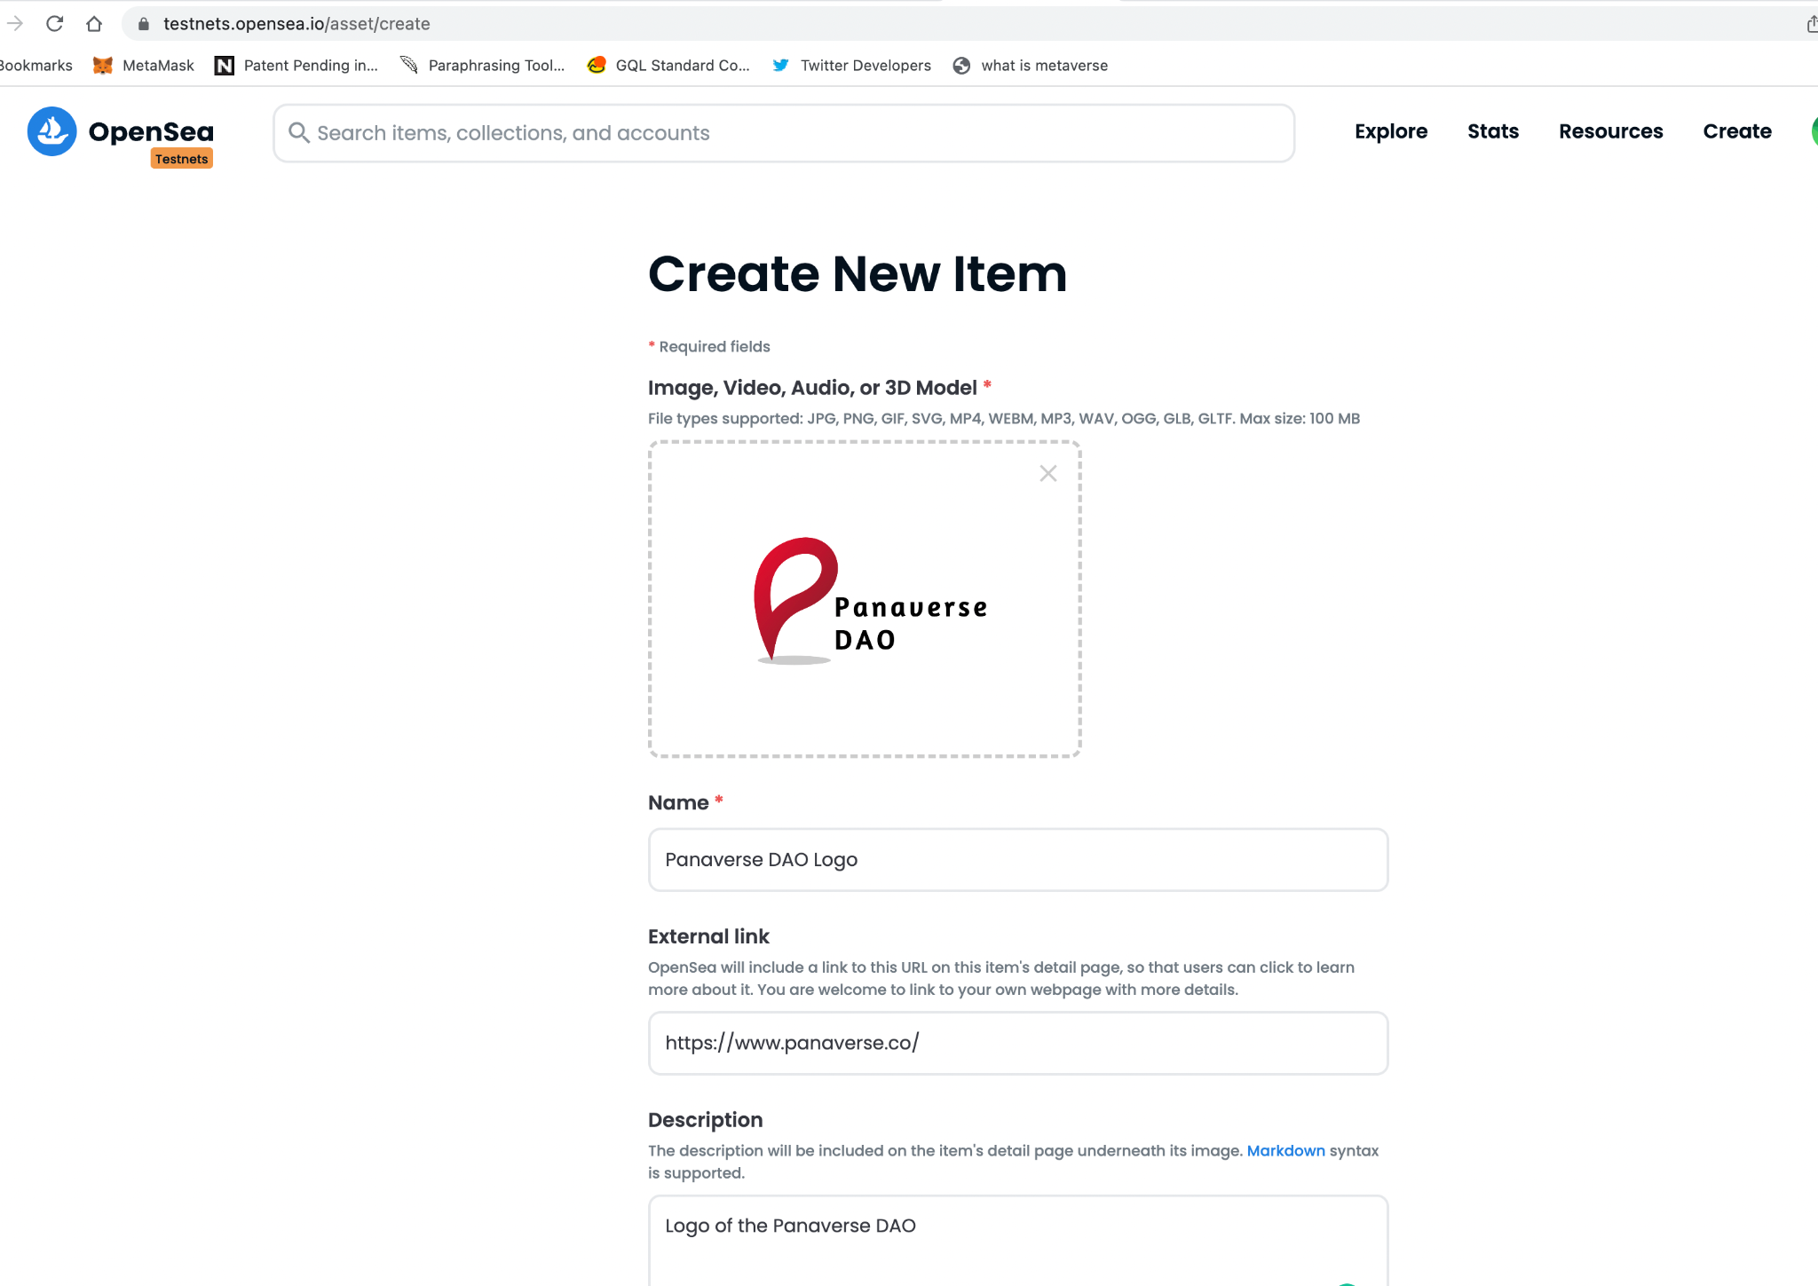
Notes:
https://testnets.opensea.io/asset/create

Slide 57
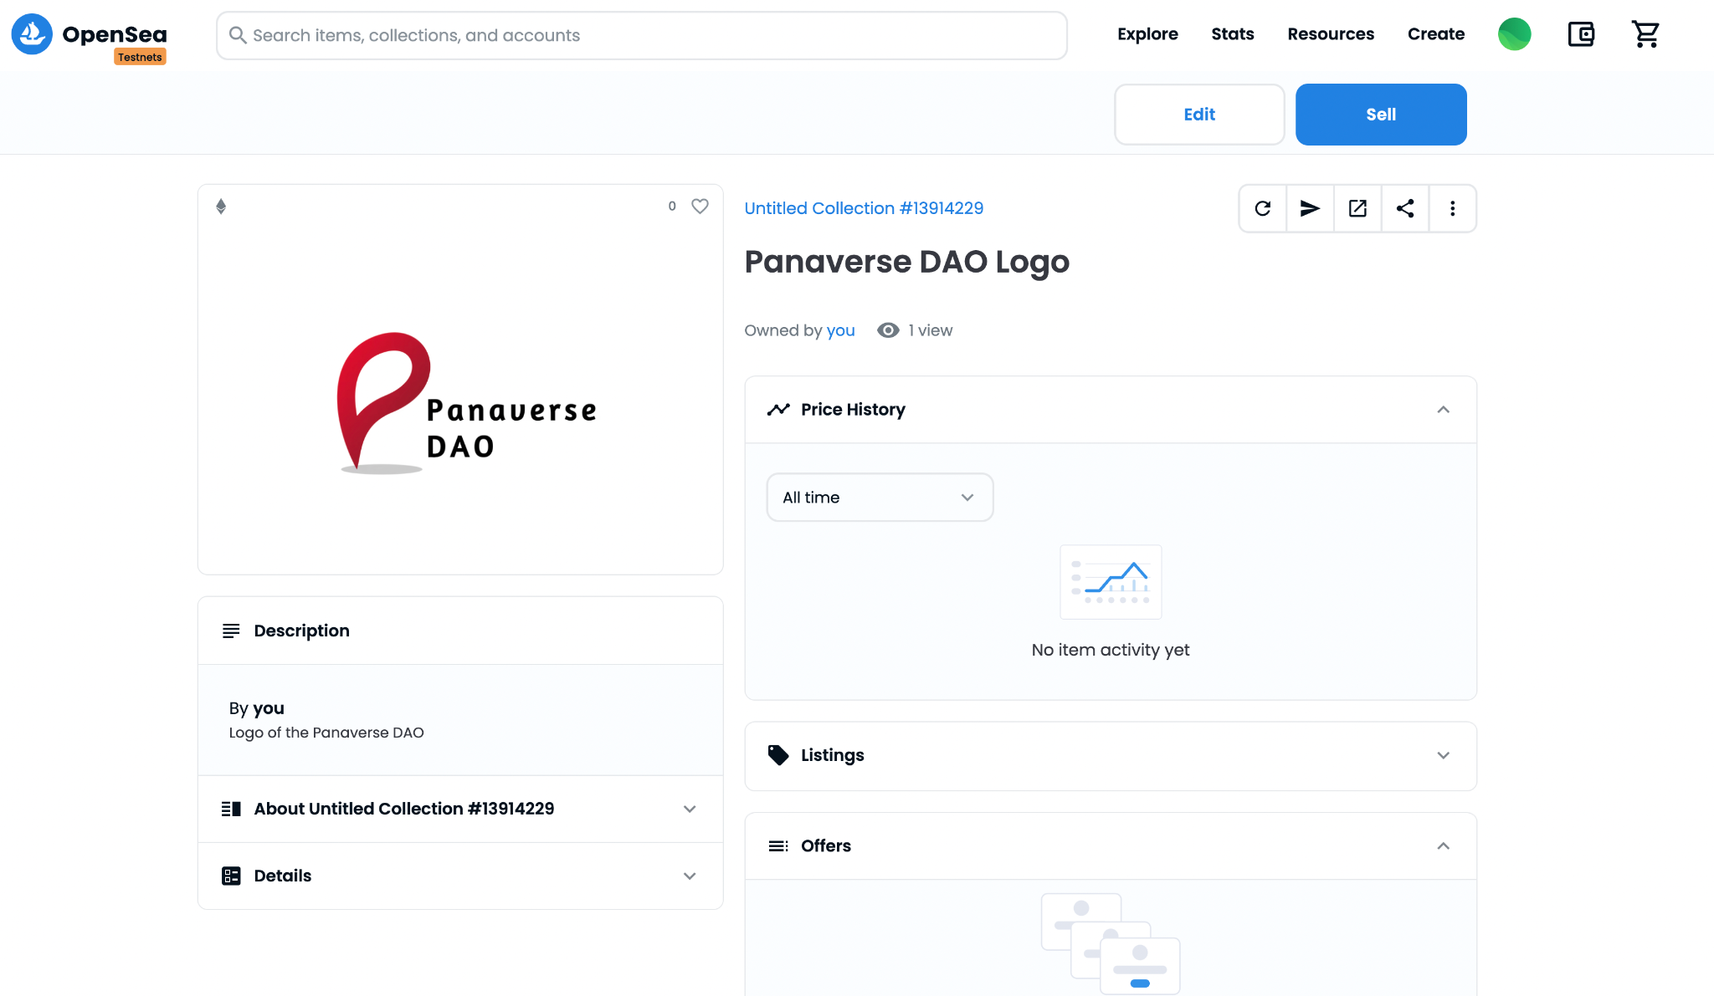
https://testnets.opensea.io/assets/goerli/0xf4910c763ed4e47a585e2d34baa9a4b611ae448c/107511843107062399913827952737187322873231599781756762181812533941645749518337/
Notes:
https://testnets.opensea.io/assets/goerli/0xf4910c763ed4e47a585e2d34baa9a4b611ae448c/107511843107062399913827952737187322873231599781756762181812533941645749518337/

Slide 58
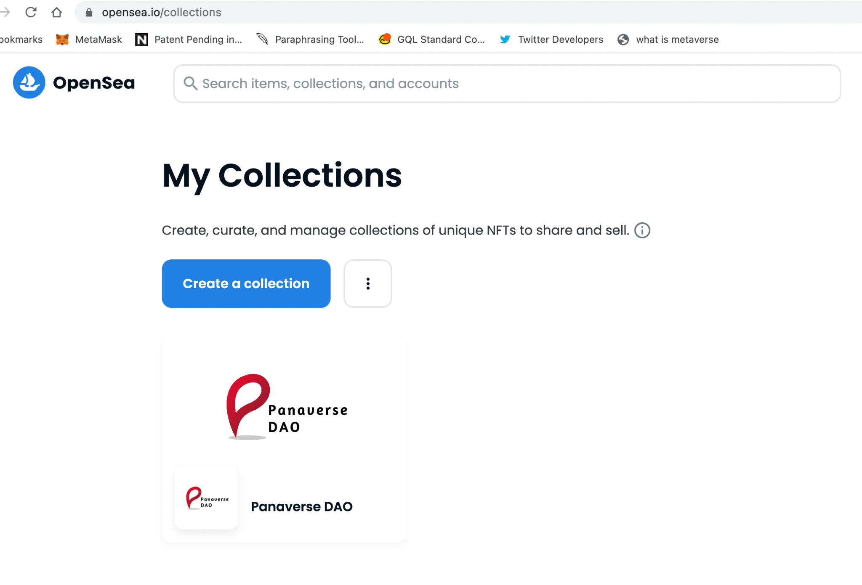
Moved to the Miannet

Slide 59
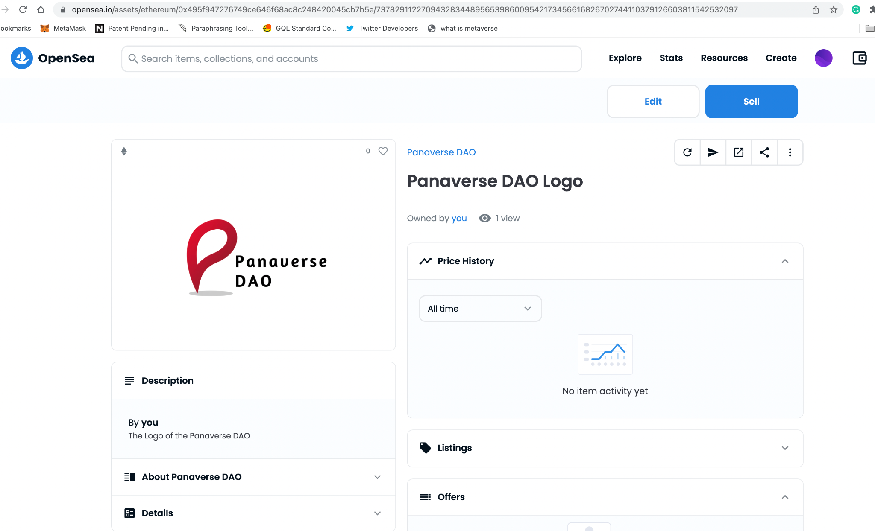
https://opensea.io/assets/ethereum/0x495f947276749ce646f68ac8c248420045cb7b5e/73782911227094328344895653986009542173456616826702744110379126603811542532097/ Published Free on Mainnet
Notes:
https://opensea.io/assets/ethereum/0x495f947276749ce646f68ac8c248420045cb7b5e/73782911227094328344895653986009542173456616826702744110379126603811542532097/
Published Free on Mainet as well

Slide 60
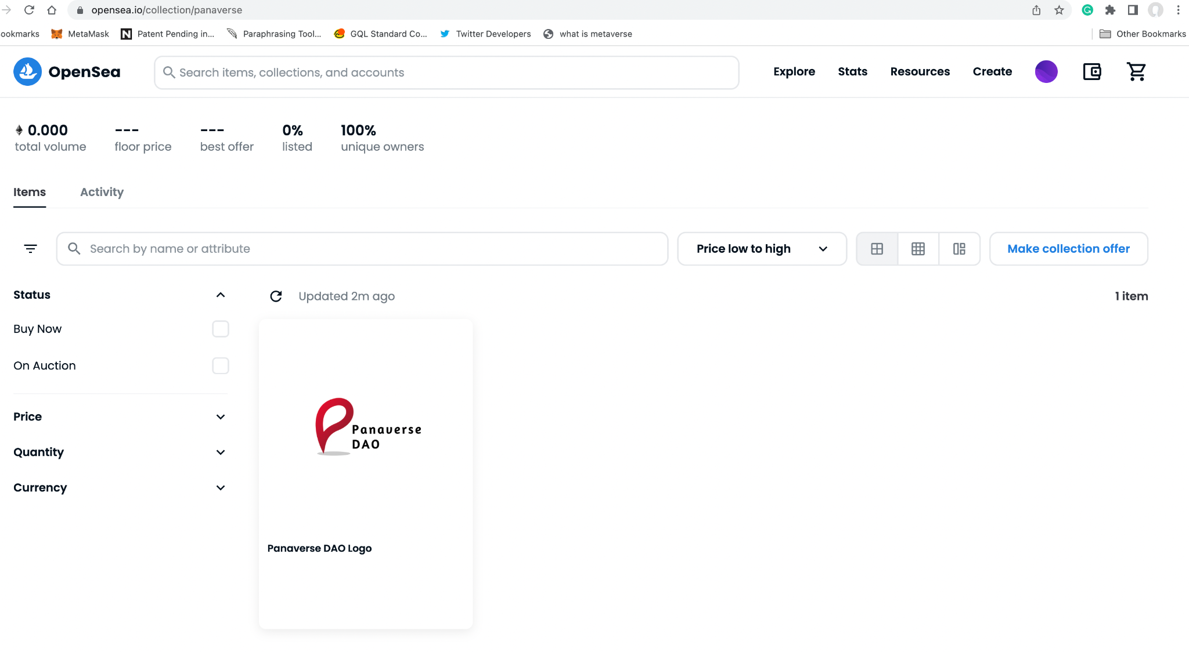
Notes:
https://opensea.io/collection/panaverse

Slide 61
Challenge Assignment: Become a Liquidity Provider on Uniswap (Goerli Testnet)
Part 1: Provide Liquidity to a existing pool
Getting Started
https://support.uniswap.org/hc/en-us/sections/8122851346573-Getting-Started
Tutorial: How to Become a Liquidity Provider on Uniswap
https://opensea.io/collection/panaverse
Part 2: Create a New Pool and Provide Liquidity
Advanced requirement is that you create a pool of your own Tokens:
https://tokpie.io/blog/how-create-pool-uniswap-erc20-pair/

Slide 62
Publish Challenge Assignment: Become a Liquidity Provider on Uniswap (Goerli Testnet)
After you have completed the challenge publish it on:
Twitter and refer to @Panaverse_edu with hashtags #web3 and #uniswap
Facebook Group:
https://www.facebook.com/groups/panaverse
Panaverse Channels on Panacloud Discord Server:
https://discord.gg/GggDkBwJDr
Whatsapp to me all the details at: 923008263374

Slide 63

Panaverse DAO
The Web 3.0 & Metaverse Team
www.panaverse.co
https://discord.gg/GggDkBwJDr
https://twitter.com/Panaverse_edu
https://www.facebook.com/groups/panaverse

